Slide 1
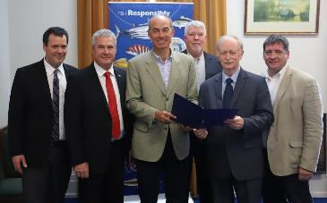
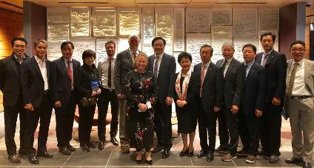
New Developments in North American Aquaculture
Presentation to shellfish futures conference 2019
Ian Dutton
Director Marine Resources
DPIPWE
ian.Dutton@dpipwe.tas.gov.au

Slide 2
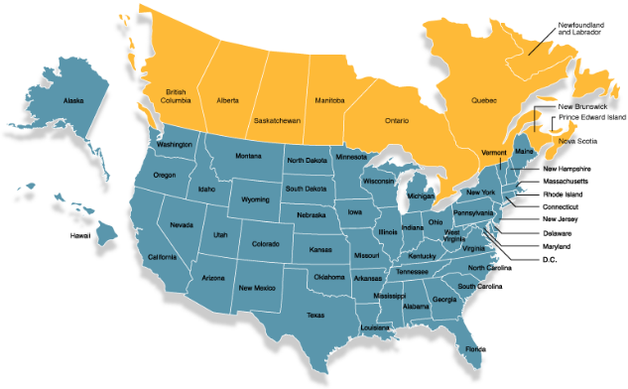
North American shellfish Aquaculture Developments/ Innovations (relevant to tas)
production and value – USA+ Canada
Enabling conditions
regional collaboration
Case Studies
  New venture planning to investment
  Carbon futures
  Seagrant role as a key RDE catalyst
  Aquaculture planning tools
  New kinds of investors/investments

Slide 3
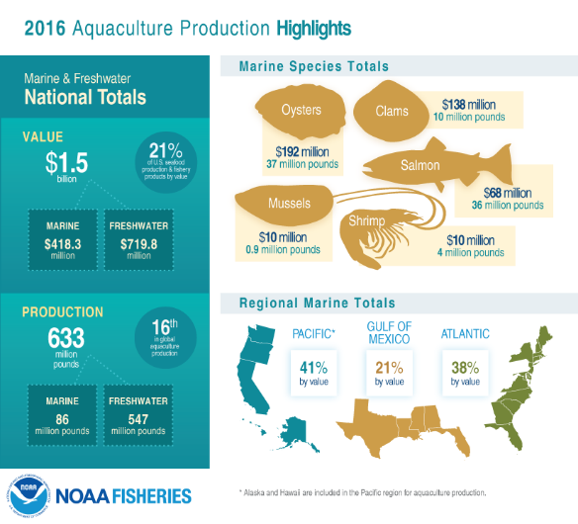

2016-17 Production Value - USA
Source: https://www.fisheries.noaa.gov/national/aquaculture/us-aquaculture

Slide 4
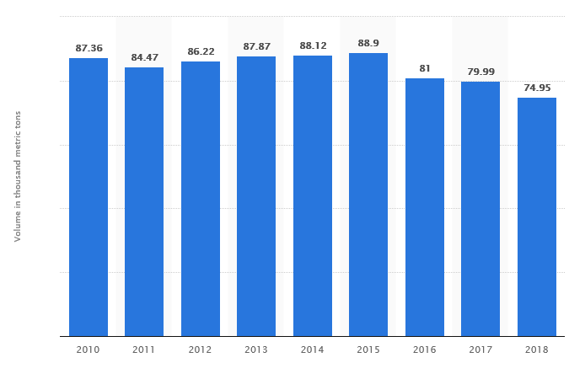
Canadian Shellfish production
(thousand metric tons)

Slide 5
2016-17 Production Value – Canadian ($000)
Source: Statistics Canada. Table 32-10-0107-01 Aquaculture, production and value

Slide 6
Key Enabling conditions
(differences with Australia/tas)
Large domestic economies with massive seafood demand and production shortfall
Increasing trade rules + restrictions creating domestic/regional growth opportunities
More flexible labour laws and pools (less restrictive immigration controls)
Ready access to quality education and training (formal and informal)
State/local “autonomy” – able to make decisions federal control (esp. USA)
More investment Intermediaries – hnw individuals, foundations, D+E NGOs etc
More risk capital and entrepreneurship – see fish 2.0
Less reliance on government – conceptually and operationally

Slide 7
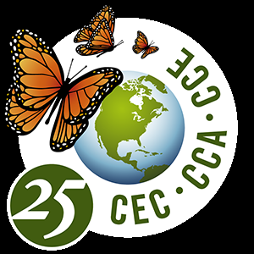
Regional collaboration
NAFTA Frameworks for Investment
US-Canada Trade - $720B
US-Mexico Trade - $671B
Blue Carbon ecosystem restoration
Great Lakes Initiatives
Academic collaborations – R+D across habitats
Gulf of Mexico program
Deepwater Horizon - $20B Trust Fund (aquaculture a big focus)
etc.

Slide 8
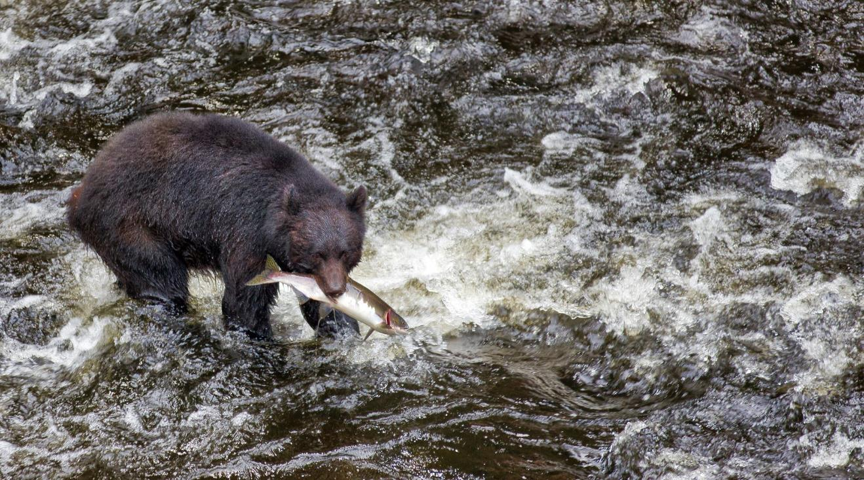
Case Studies

Slide 9
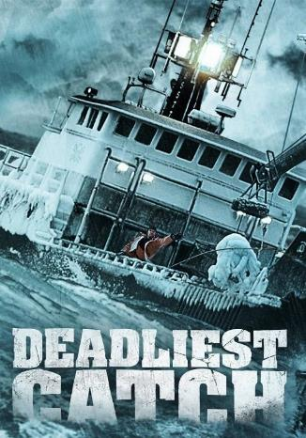
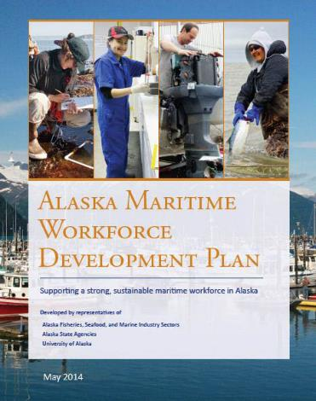
Alaska shellfish aquaculture Development
https://maritimeworks.org/

Slide 10
Alaskan fisheries development foundation mariculture Development strategy
A Plan for Action
Secure Seed Supply through Hatcheries
Establish an Alaska Mariculture Development Council
Maximize Innovation and Growth through Research
Align Laws, Regulations and Agency Practices with Stakeholder Needs
Secure and Promote Investment in Mariculture
Build Public Understanding and Support for Mariculture
Promote Success through Alaska Native Participation
Grow and Develop the Mariculture Workforce
Develop New Mariculture Markets and Products
https://www.afdf.org/wp-content/uploads/Alaska-Mariculture-Development-Plan_v2018-06-29_FINAL_digital.pdf
https://www.afdf.org/projects/current-projects/alaska-mariculture-initiative/

Slide 11
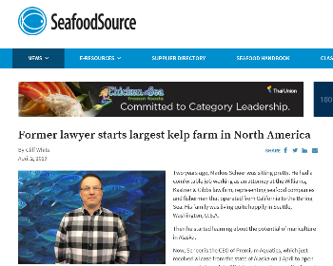
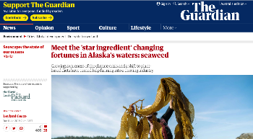
IMTA – INTEGRATED MULTI TROPHIC AQUACULTURE
Premium Aquatics (+ Seagrove Kelp Co.)
CEO – Board member of AFDF
127 acre kelp and shellfish farm
  100 acres for bull, sugar and ribbon kelp
  27 acres for Pacific oyster (19 million oysters/yr)
  Current site revenue projection is $15,000,000 to $20,000,000 per year.
4 additional site lease applications pending review - 600 acres of production - adds 60,000,000 oysters and 5,000 tons of production capacity.
Gross revenue projections from those sites exceed $50,000,000 per year.
https://www.seafoodsource.com/news/aquaculture/former-lawyer-starts-largest-kelp-farm-in-north-america

Slide 12
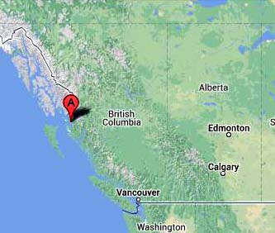
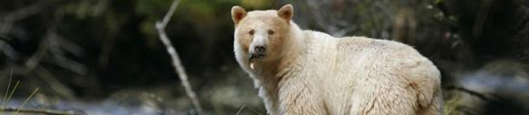
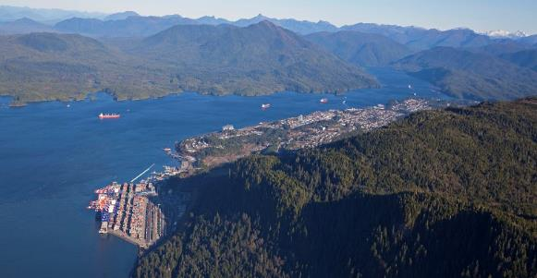
Great Bear Rainforest/Haida Gwai scallops
http://coastalshellfish.com/
https://coastfunds.ca/news/new-first-nations-investments-sustainable-scallops-in-prince-rupert-and-an-oceans-forum-for-haida-gwaii/

Slide 13
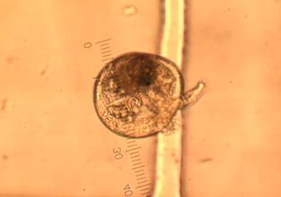
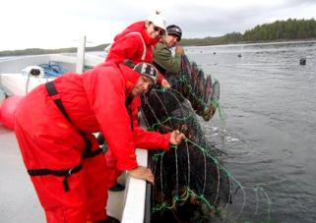
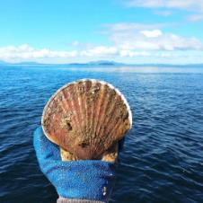
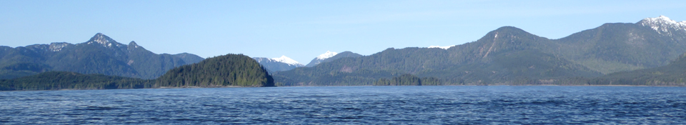
Great Bear Rainforest/Haida Gwai scallops

Slide 14
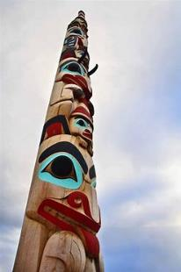
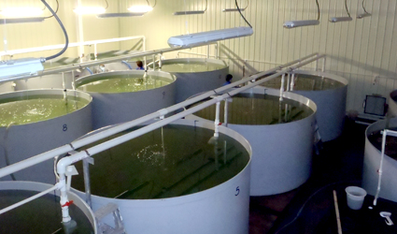
Coastal shellfish
First nations enterprise
Coastal shellfish began 2011 w/commercial partnership
Significant commercial, tribal and philanthropic investment
Proof of concept 4 years/small scale sales and production/capacity building
2019 commercial scale production

Slide 15
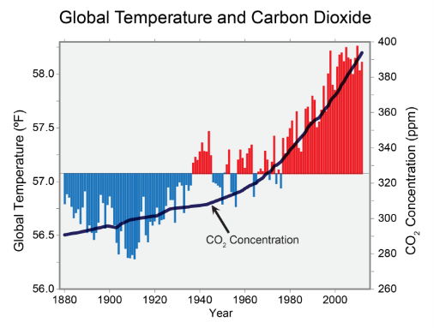
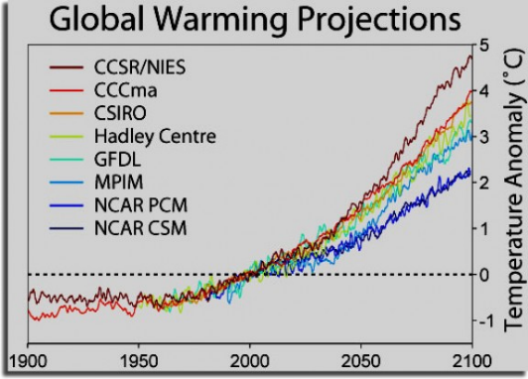
Carbon challenges now + getting worse

Slide 16
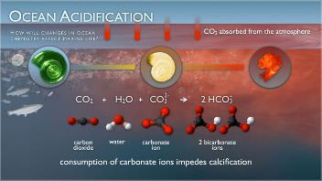
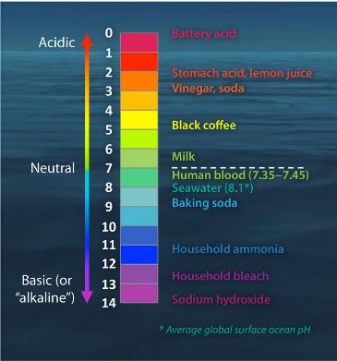
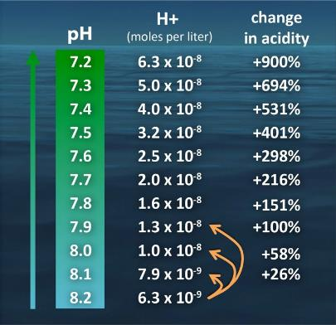
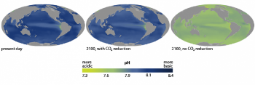
Since 1850 ocean ph has decreased from 8.16 to about 8.07 and is projected to reach 7.67 by 2100*
https://www.pmel.noaa.gov/co2/
https://www.climate.gov/news-features/featured-images/ocean-acidification-today-and-future

Slide 17
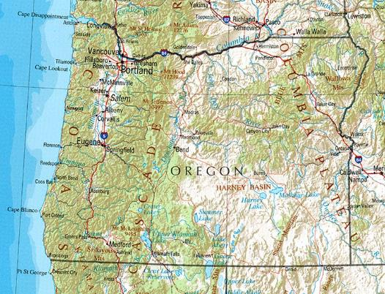

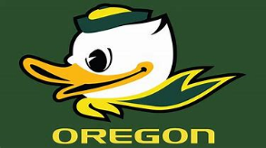
Oregon state hatcheries and oa

Slide 18
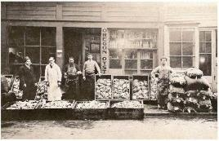
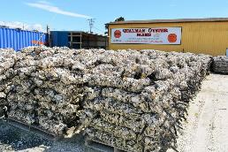
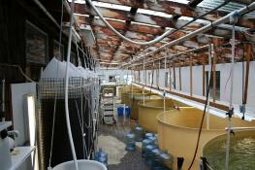
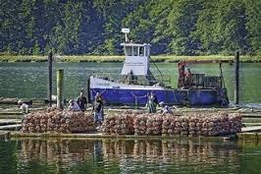
Oregon oysters impact and industry response
West coast oyster growers (mostly OR) Employ 3,000 and generate $207M/yr
2006-08 Oregon oyster larvae die off rates >70% - initially blamed Vibrio tubiashii
Cause was Lack of aragonite in first 24-48 hrs
Six years of failed reproduction
Now have real time monitoring of ph and rearing tank buffering systems
https://e360.yale.edu/features/northwest_oyster_die-offs_show_ocean_acidification_has_arrived
https://seagrant.oregonstate.edu/sites/seagrant.oregonstate.edu/files/confluence/confluence-2-1-web.pdf

Slide 19
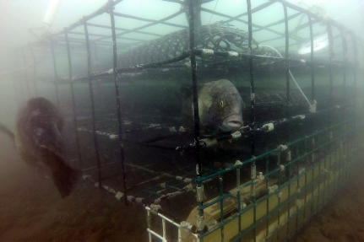
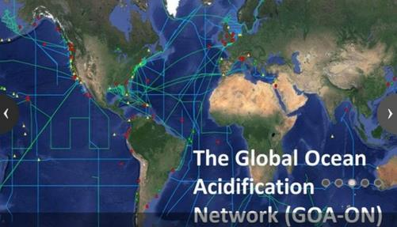
Institutional oa response 2009-19
Noaa supports grower-based monitoring programs
Global ocean acidification monitoring program
https://www.fisheries.noaa.gov/feature-story/noaa-fisheries-lab-helps-shellfish-growers-become-citizen-scientists
https://oceanacidification.noaa.gov/

Slide 20
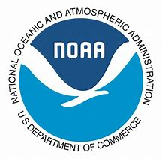
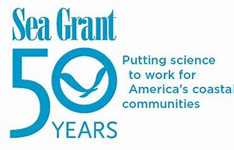
Seagrant – rde on a mission
Sea Grant's mission is to enhance the practical use and conservation of coastal, marine and Great Lakes resources in order to create a sustainable economy and environment.
33 state university-based programs with several national hubs
Focus areas:
  Healthy coastal ecosystems
  Sustainable fisheries and aquaculture
  Resilient communities & economies
  Environmental literacy and workforce development

Slide 21
Noaa-Seagrant 2016-2026 aquaculture vision
$50-100M investment over 10 years
Priority focus areas:
  Commerce
  Permitting and policies
  Current and emerging species
  Production systems
  Seafood safety and quality

Slide 22
Noaa-Seagrant:
Focal Areas for aquaculture Investment
https://seagrant.noaa.gov/Portals/0/Documents/Handouts/AquacultureVisionNOAA_March2016.pdf

Slide 23

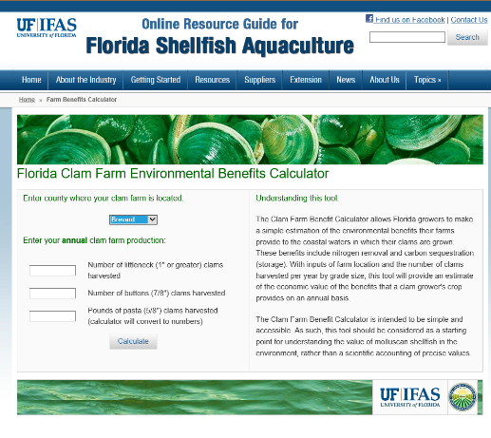
How green is your shellfish?
30 years of shellfish industry development
Florida clam farming industry supports about 250 growout operations on 1,500 acres of state-owned submerged lands
543 jobs
Gross revenue impact to the state’s economy, estimated to be $38.7M
http://shellfish.ifas.ufl.edu/industry/

Slide 24
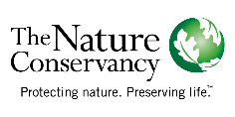
Oyster reef restoration: From Global Assessment to Local action
Source: http://www.issc.org/Data/Sites/1/media/tnc-bozehancock%20issc%20restorationsubcomm%20oct09.pdf

Slide 25

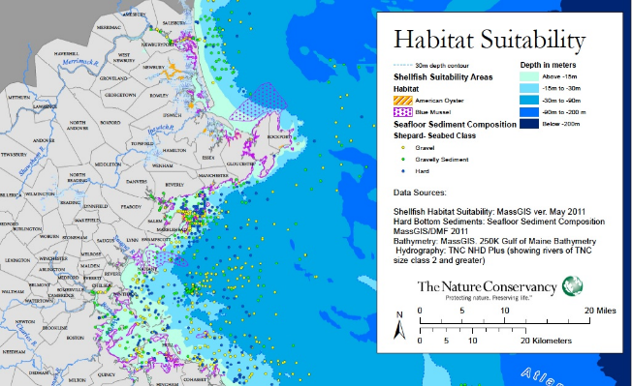
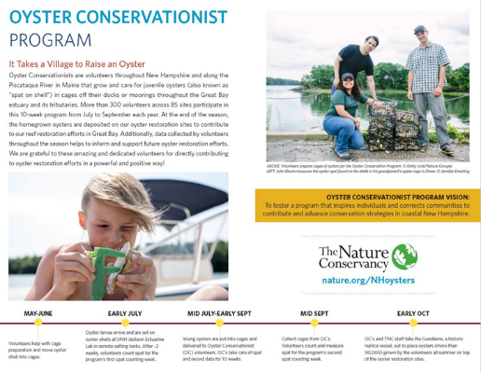
initiatives to leverage impact + investment
Massachusetts
New hampshire

Slide 26
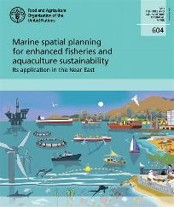
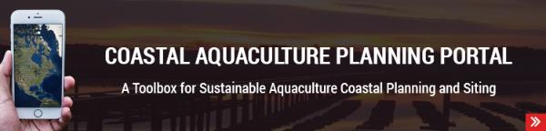
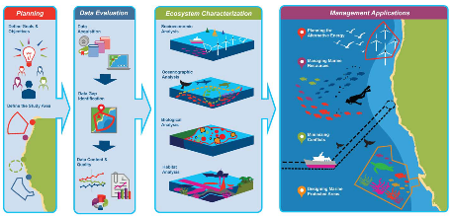
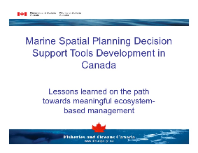
aquaculture planning and decision support
https://coastalscience.noaa.gov/research/marine-spatial-ecology/aquaculture/

Slide 27
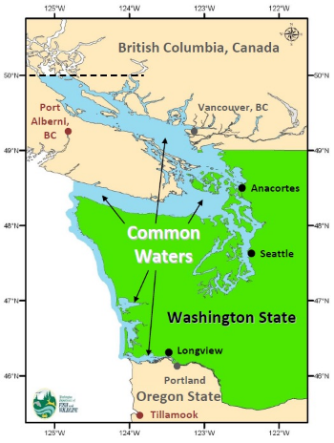
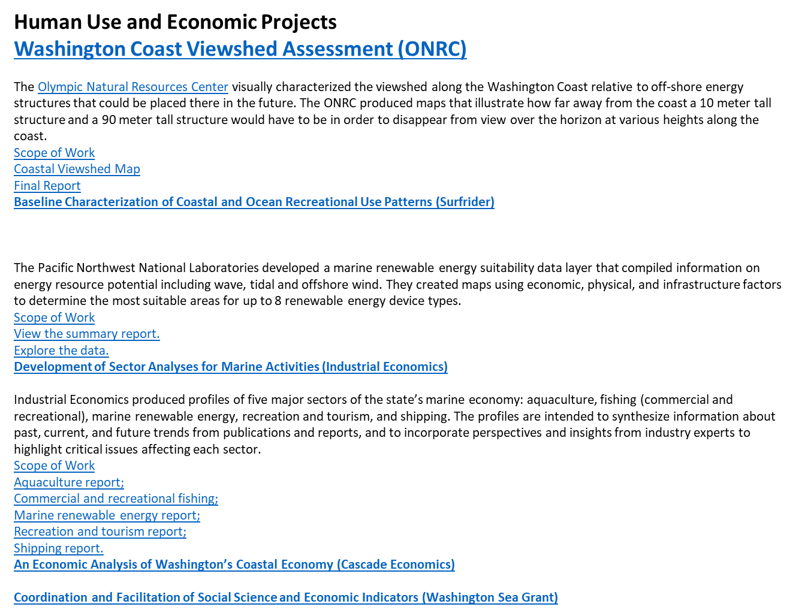
Coastal planning decision support tool – allows stakeholders to ask “what if?”
Washington State Example: http://mapview.msp.wa.gov/default.aspx

Slide 28
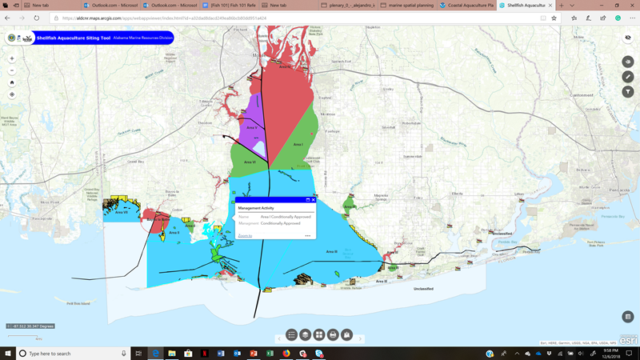
Alabama - Publicly accessible decision support tool for aquaculture planning
https://aldcnr.maps.arcgis.com/apps/webappviewer/index.html?id=a32dad8dacd249ea86bcb80dd951a424

Slide 29
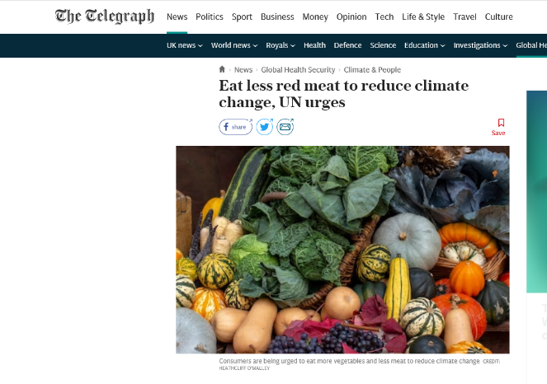
Did anyone see headlines like this last week?

Slide 30
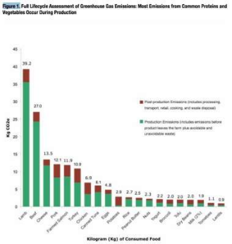
Hoof print substitution = Imta opportunity
…if the entire US stopped eating meat. It'd be like taking 60 million cars off the road.
https://www.businessinsider.com.au/switch-from-meat-to-meatless-diet-environmental-benefits-2019-8

Slide 31
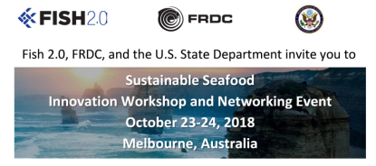

Start Ups, innovation sprints and impact capital
https://www.fish20.org/
https://www.oneforneptune.com/
https://salmonfund.com/

Slide 32

Questions?

