Slide 1

Breeding for POMS Resistance:
The latest improvements
Peter Kube (CSIRO) and Matt Cunningham
Shellfish Futures, 17 August 2019

Slide 2
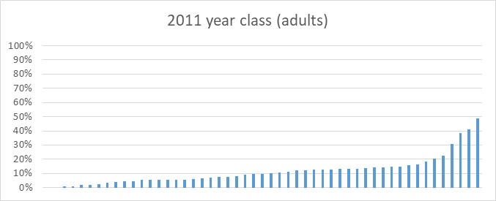
The story so far … one year old resistance

Slide 3
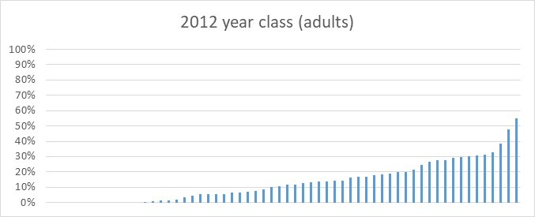
The story so far … one year old resistance

Slide 4
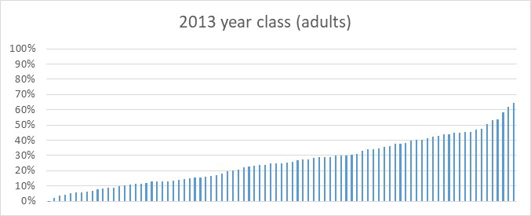
The story so far … one year old resistance

Slide 5
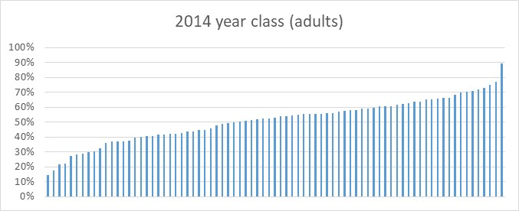
The story so far … one year old resistance

Slide 6
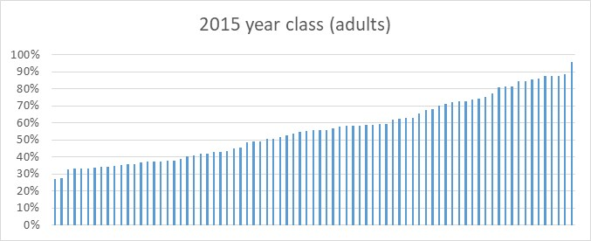
The story so far … one year old resistance

Slide 7
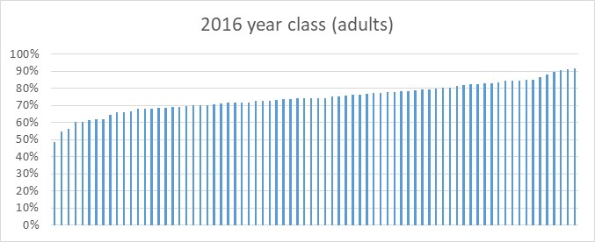
The story so far … one year old resistance

Slide 8
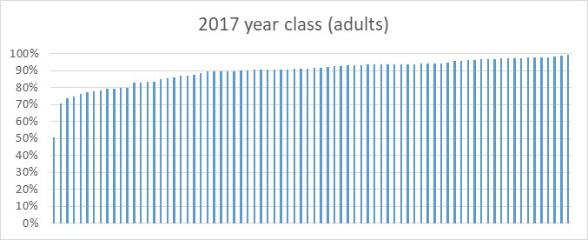
The story so far … one year old resistance

Slide 9
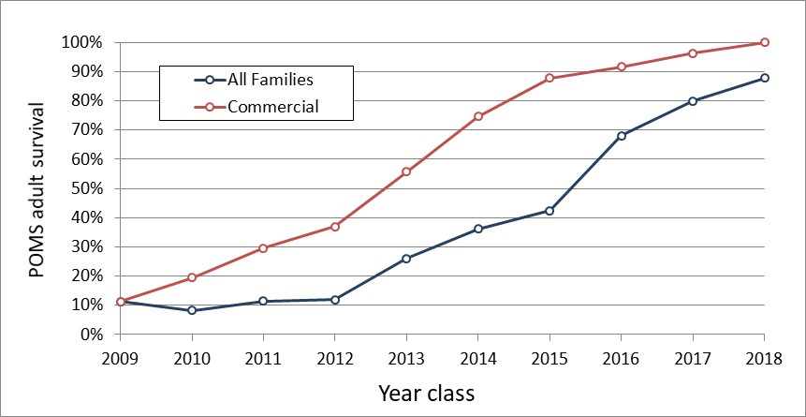
One year old resistance – genetic trend
Commercial Release 2018

Slide 10
Spat resistance … the next part
Year Class | Number Trials | Average Survival | Number oysters | How good were the trials?
2016 | 2 | 18% | 26,763 | 2 passable
2017 | 5 | 13% | 99,059 | 1 passable, 3 reasonable, 1 good
2018 | 5 | 35% | 151,750 | 2 good, 3 very good

Slide 11
Spat resistance … the next part
Year Class | Number Trials | Average Survival | Number oysters | How good were the trials?
2016 | 2 | 18% | 26,763 | 2 passable
2017 | 5 | 13% | 99,059 | 1 passable, 3 reasonable, 1 good
2018 | 5 | 35% | 151,750 | 2 good, 3 very good

Slide 12
Spat resistance … the next part
Year Class | Number Trials | Average Survival | Number oysters | How good were the trials?
2016 | 2 | 18% | 26,763 | 2 passable
2017 | 5 | 13% | 99,059 | 1 passable, 3 reasonable, 1 good
2018 | 5 | 35% | 151,750 | 2 good, 3 very good

Slide 13
Spat resistance … different POMS severities
Year Class | Site (Farm) | Measure Date | Survival | POMS severity
2018 | Pittwater (Josh Poke) | 31-Jan 2019 | 15% | Severe
2018 | Pittwater (Tony Burns) | 21-Feb-2019 | 32% | Moderate
2018 | Pipeclay (Shellfish Culture) | 18 Mar-2019 | 30% | Moderate
2018 | Pittwater (Josh Poke) | 11-Apr-2019 | 47% | Light
2018 | Pittwater (Tony Burns) | 15-Apr-2019 | 50% | Light

Slide 14
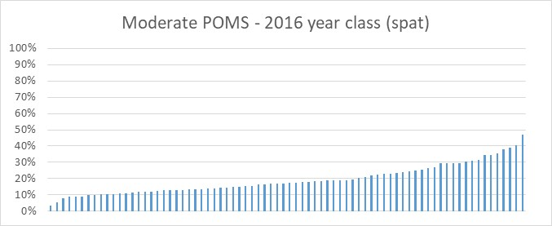
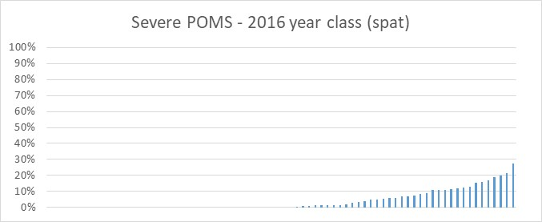
Spat resistance … the next part

Slide 15
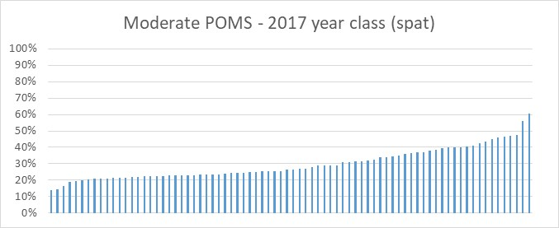
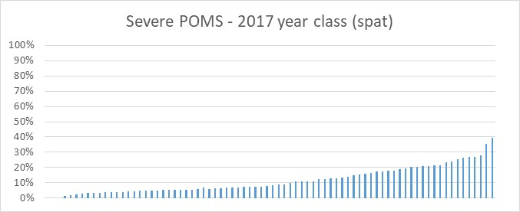
Spat resistance … the next part

Slide 16
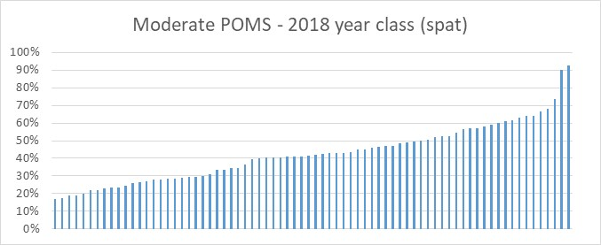
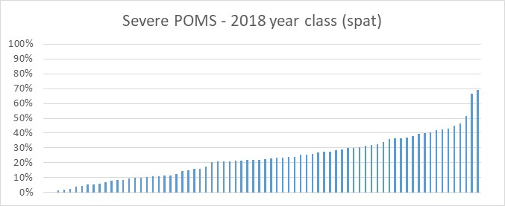
Spat resistance … the next part

Slide 17
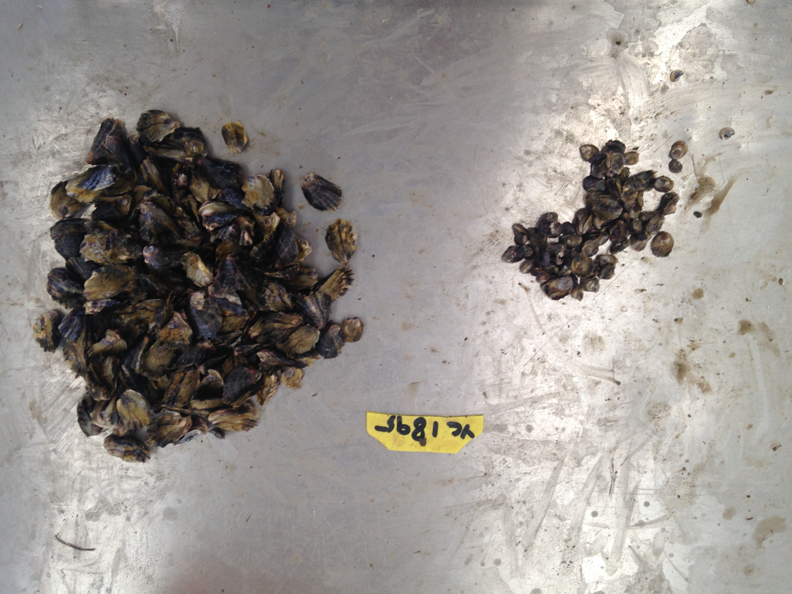
Best family 2018 year class
114 alive (66%)
58 dead (34%)

Slide 18
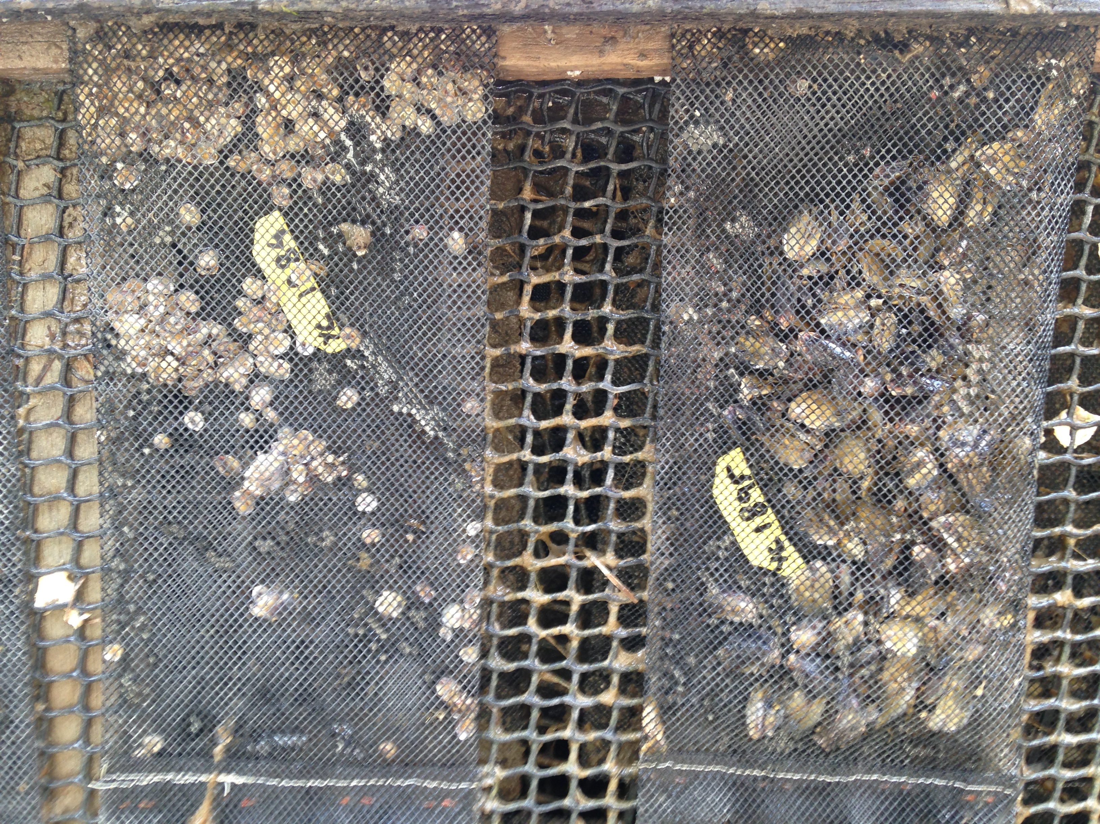
Best family 2018 year class

Slide 19
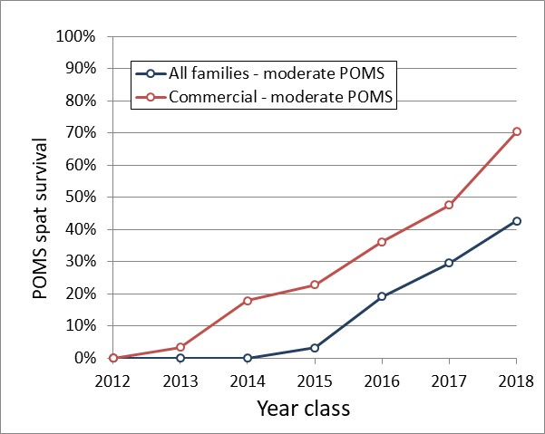
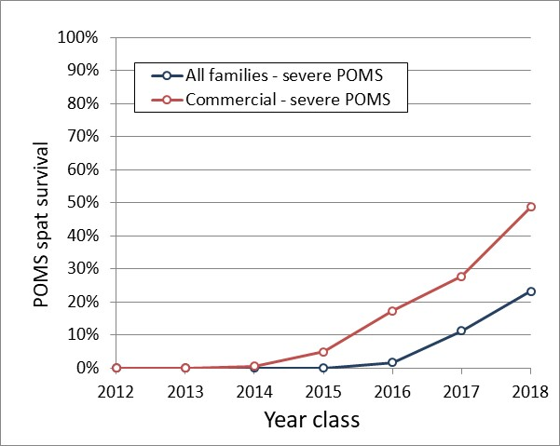
Spat resistance – genetic trend
MODERATE POMS
SEVERE POMS
Rate of gain = 13% per year
Rate of gain = 8% per year

Slide 20
The main messages
One year old stock now has high POMS resistance and our ability to keep improving that trait has plateaued
Spat resistance is now the focus and is a work in progress
Growers will need to “manage around” POMS for spat for probably the next 5 years, but high spat resistance is possible

