Slide 1
You are the tasmanian brand
August 17, 2019

Slide 2
All people, but especially the young, tend to become what society says they are.
-Robert Hughes, Fatal Shore: The Epic of Australia’s Founding

Slide 3
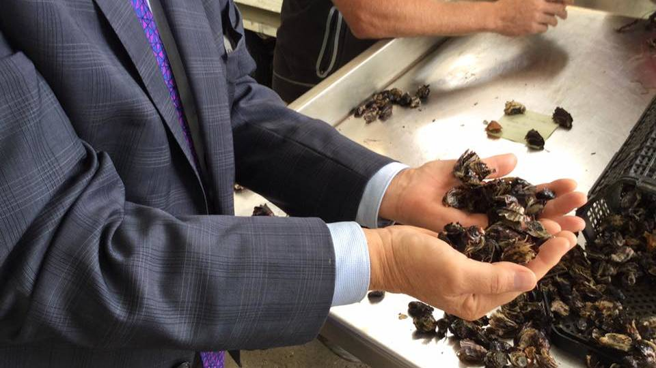
Notes:
In 2016, something terrible happened here.

Slide 4
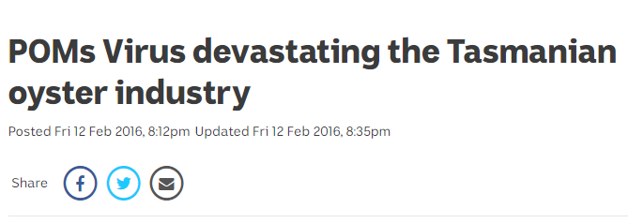

Slide 5
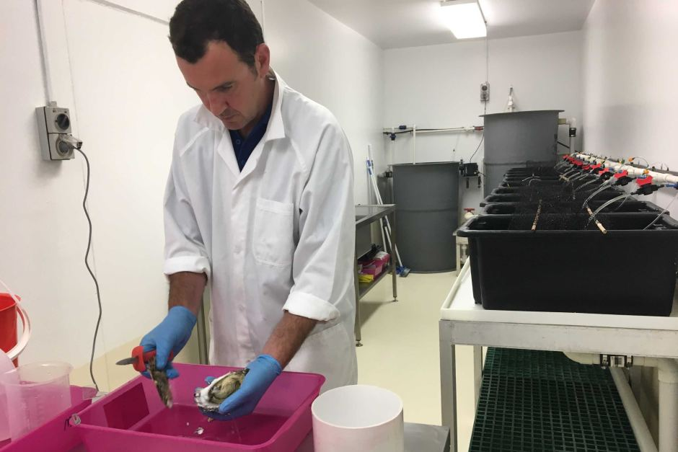
Notes:
But you didn’t give up. You didn’t import a solution. You found a Tasmanian way to respond: scientists, the industry, the government… consumers.

Slide 6
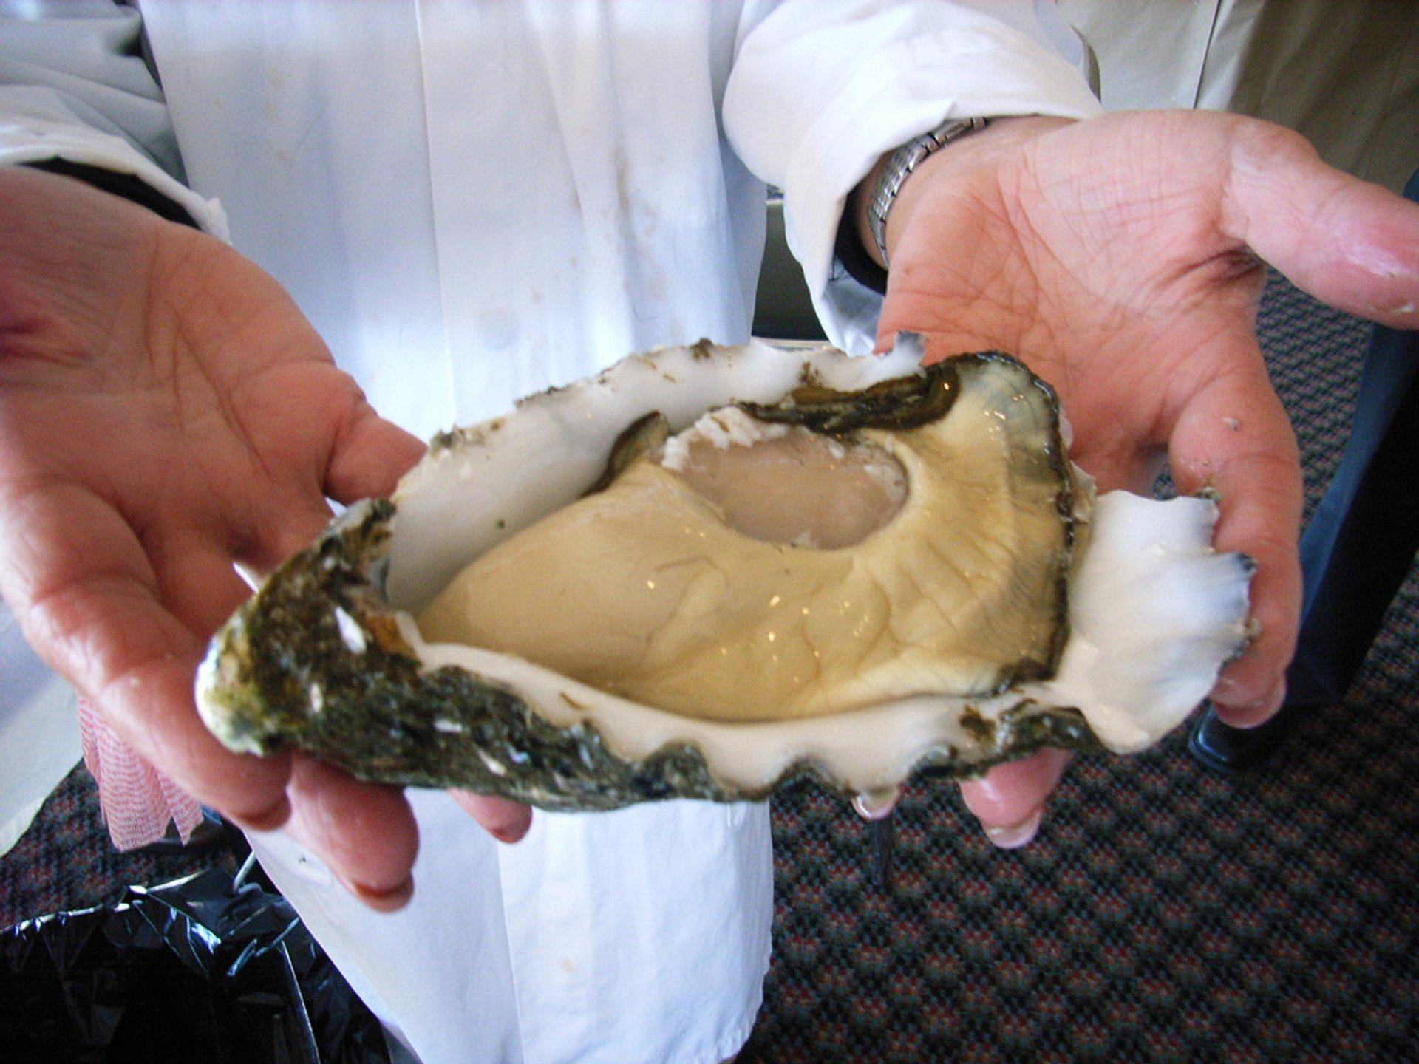
Notes:
You brought it back to life.

Slide 7
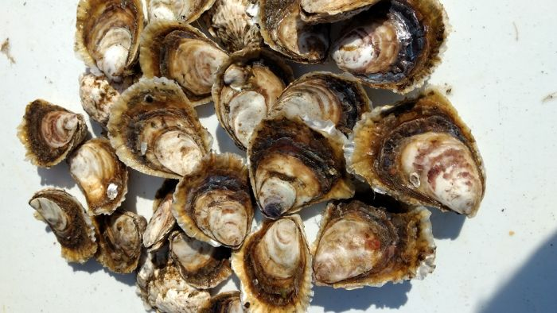
Notes:
Now, some of you are resurrecting parts of the industry that had seemed lost – a very Tasmanian thing to do.

Slide 8
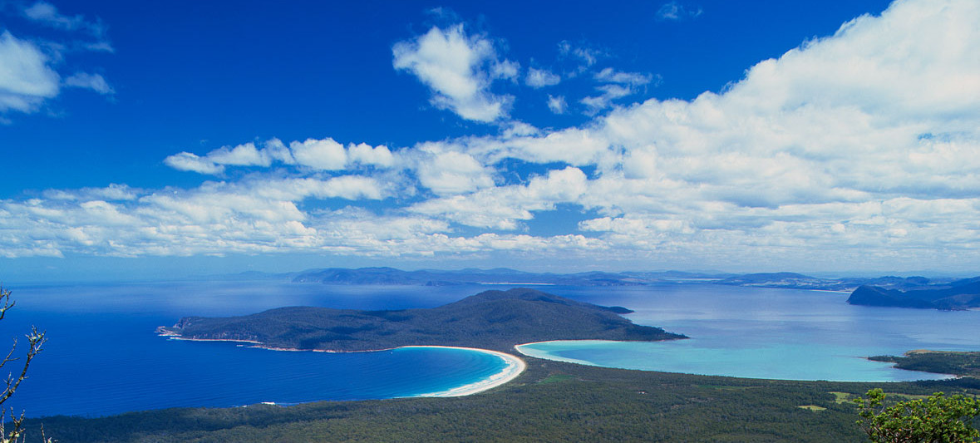

Slide 10
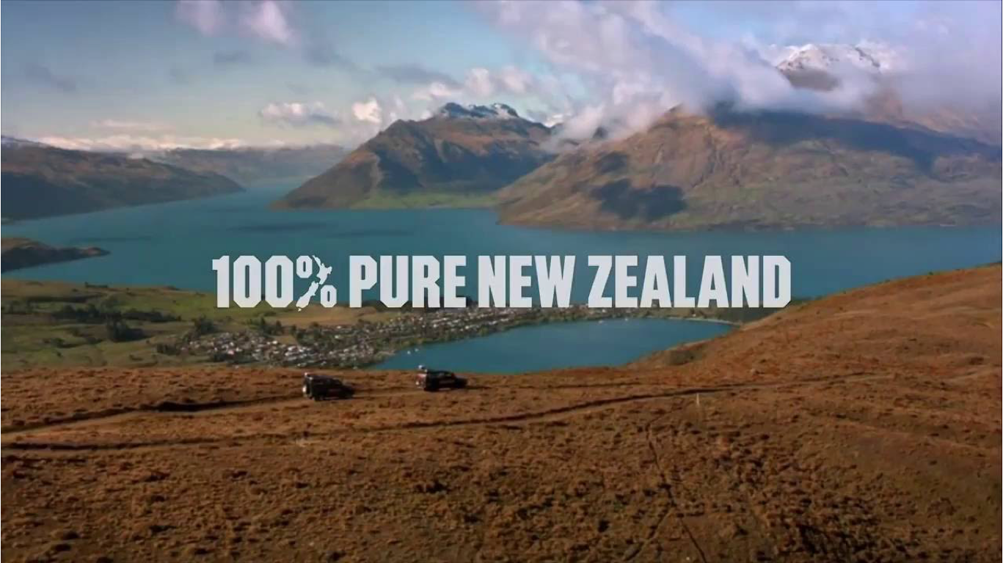

Slide 11
Notes:
This is our platform…

Slide 12
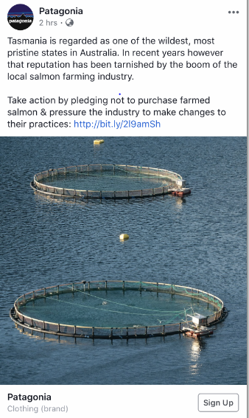
Notes:
This is our platform…

Slide 13
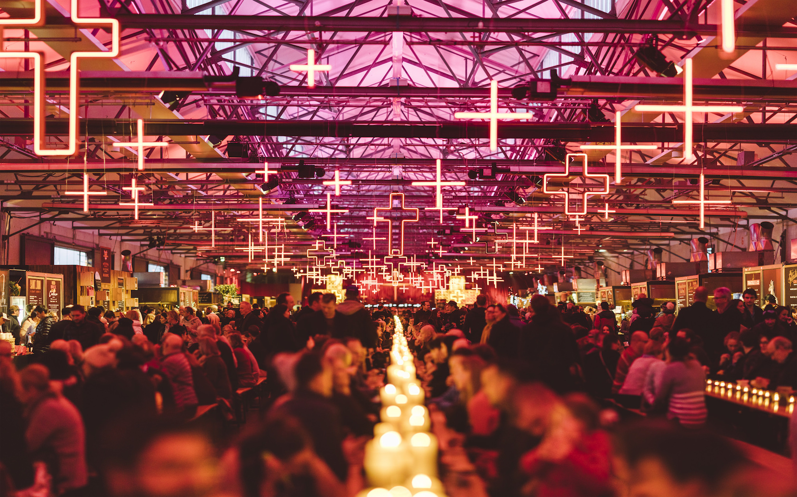

Slide 14
a cultural expression

Slide 15
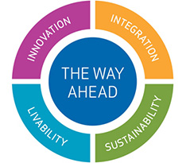

Slide 16
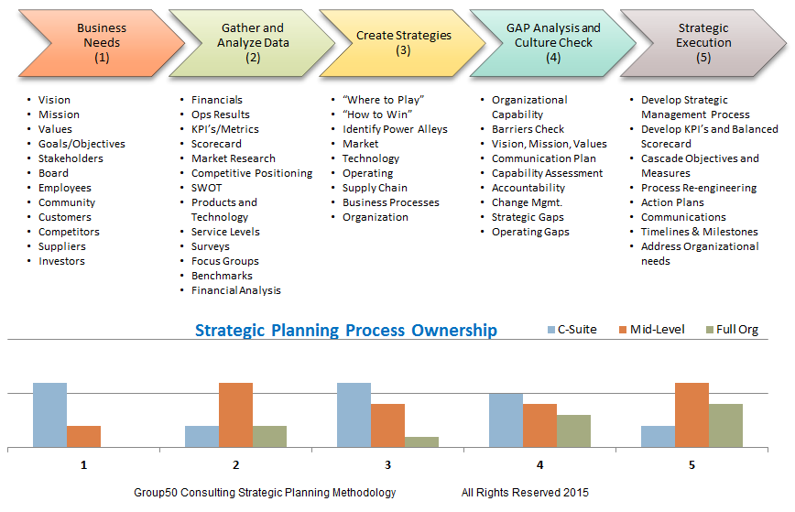
Notes:
No one knows what any of this means - including brand experts.

Slide 17
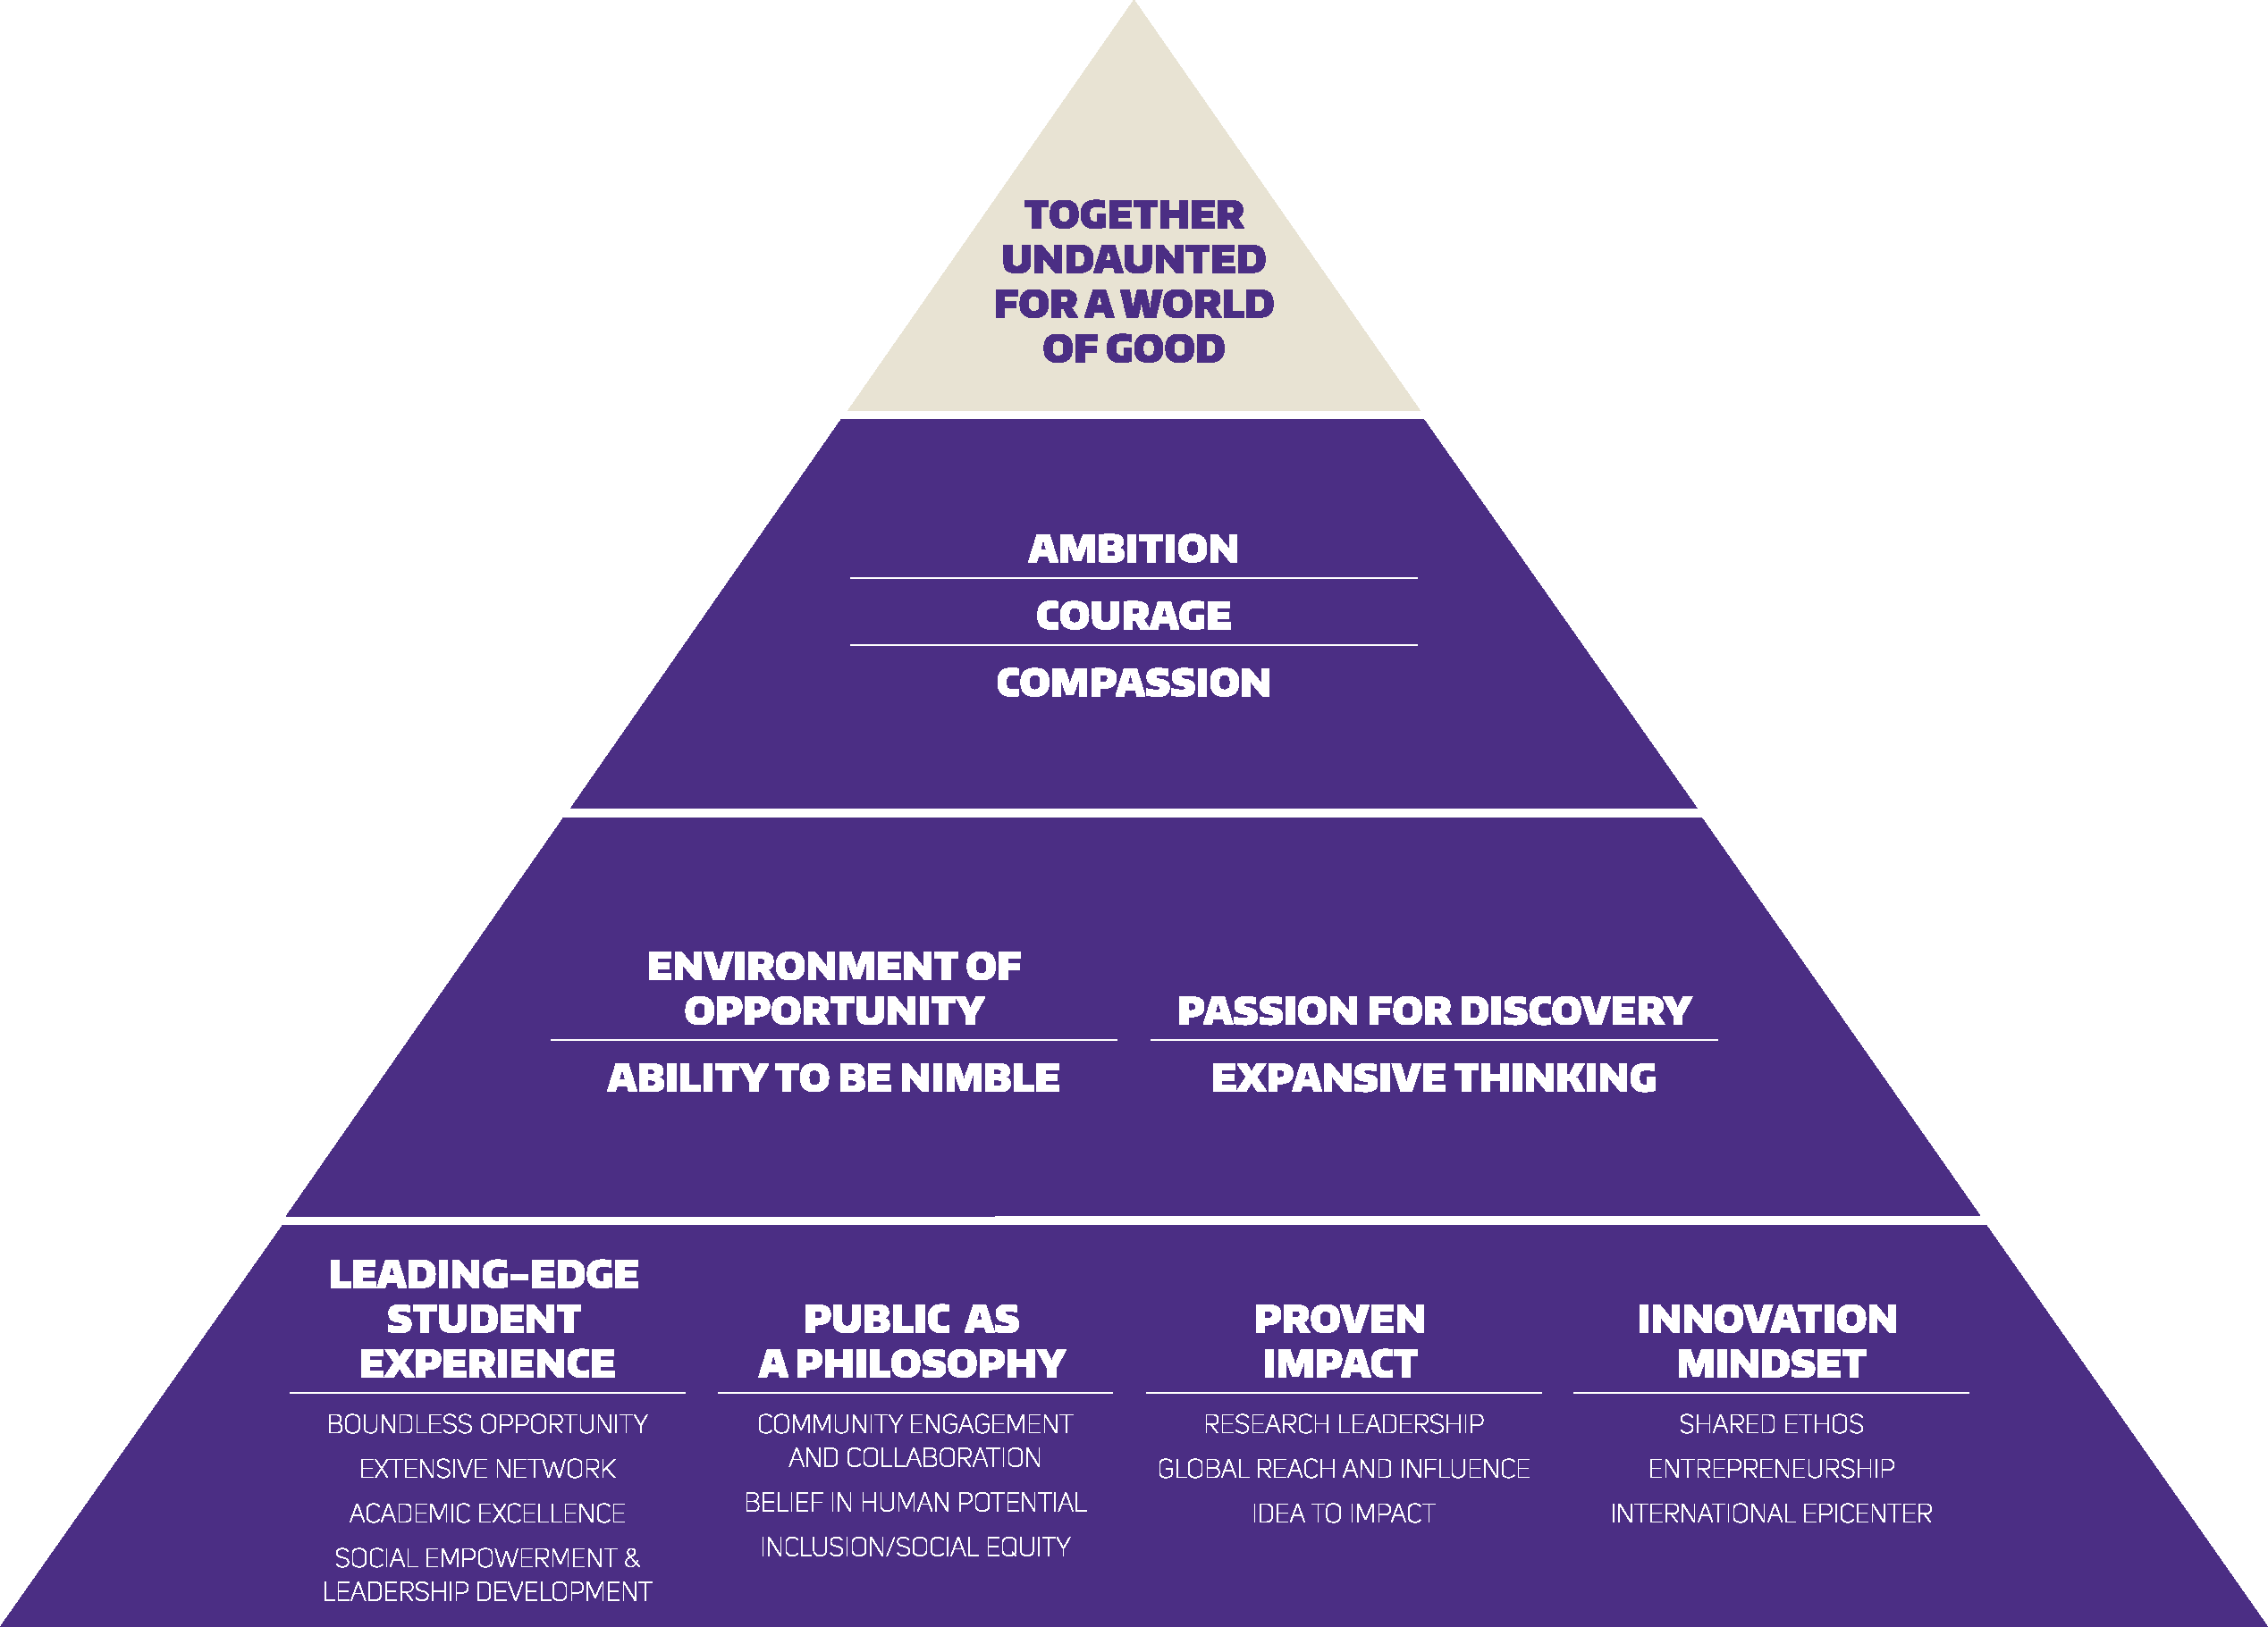
Notes:
No one knows what any of this means - including brand experts.

Slide 18
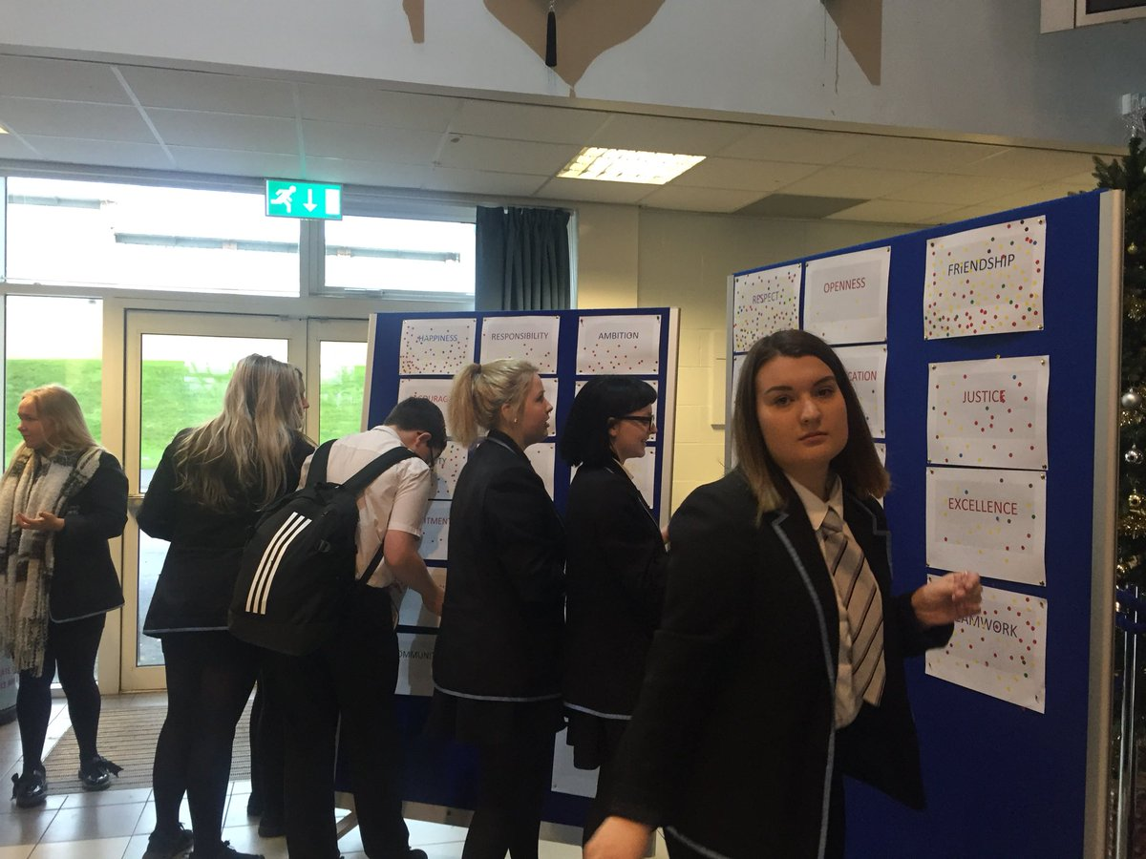

Slide 19
Universal synonyms of civic goodness

Slide 20
Notes:
The usual solution

Slide 22
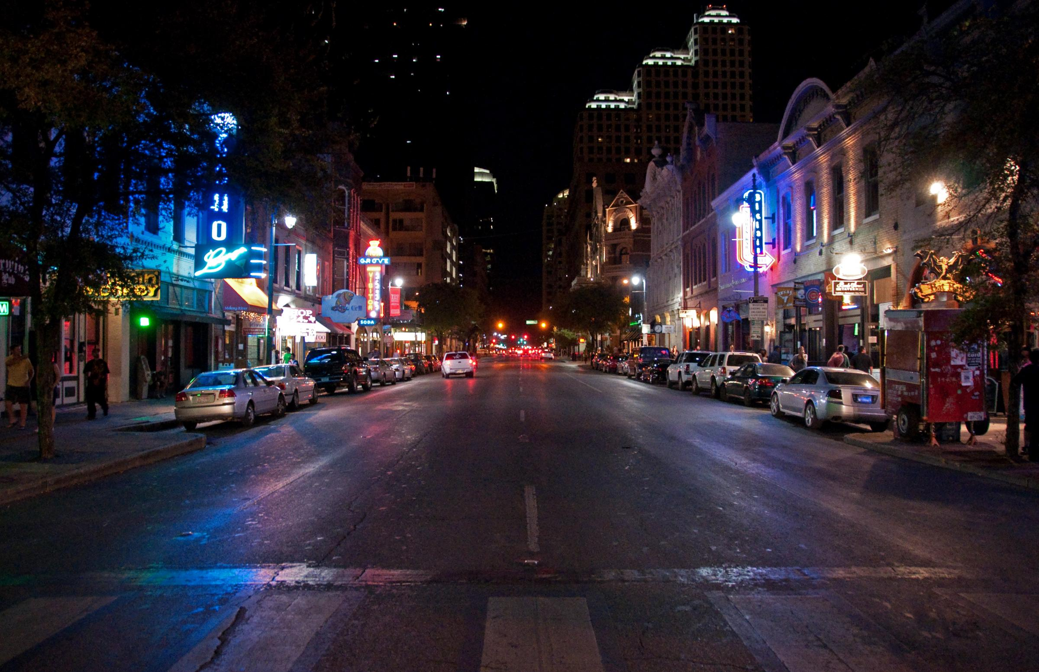
AUSTIN, 1999

Slide 23
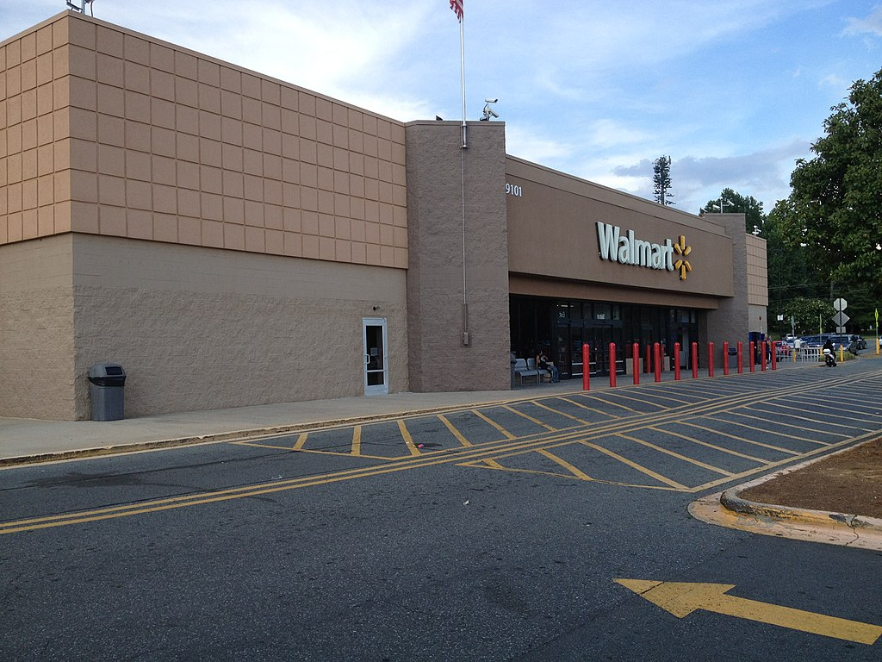

Slide 25
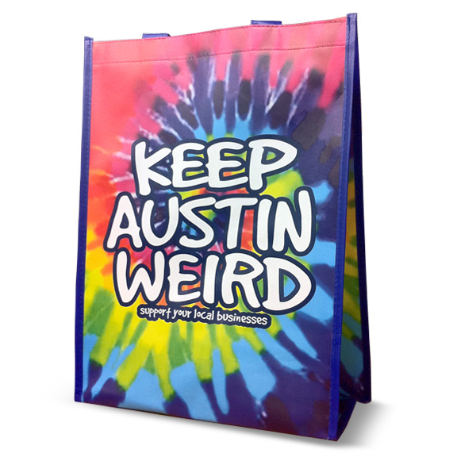
Notes:
Marc Ott

Slide 26
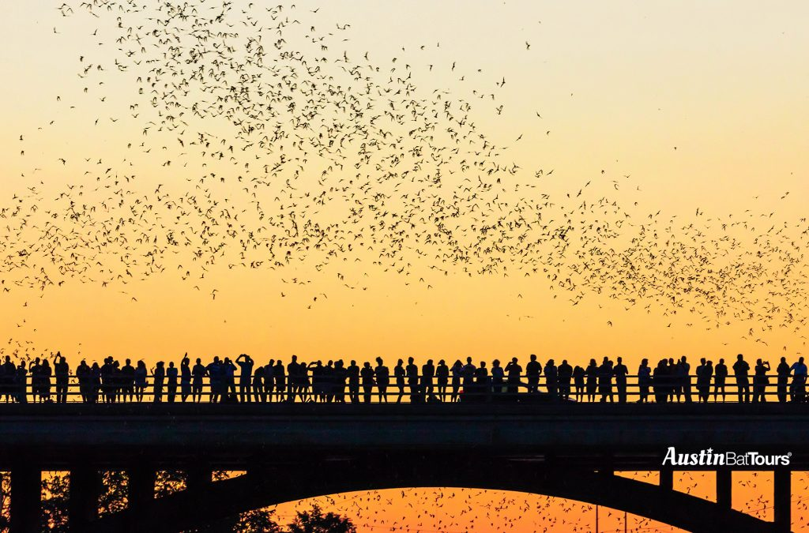

Slide 27
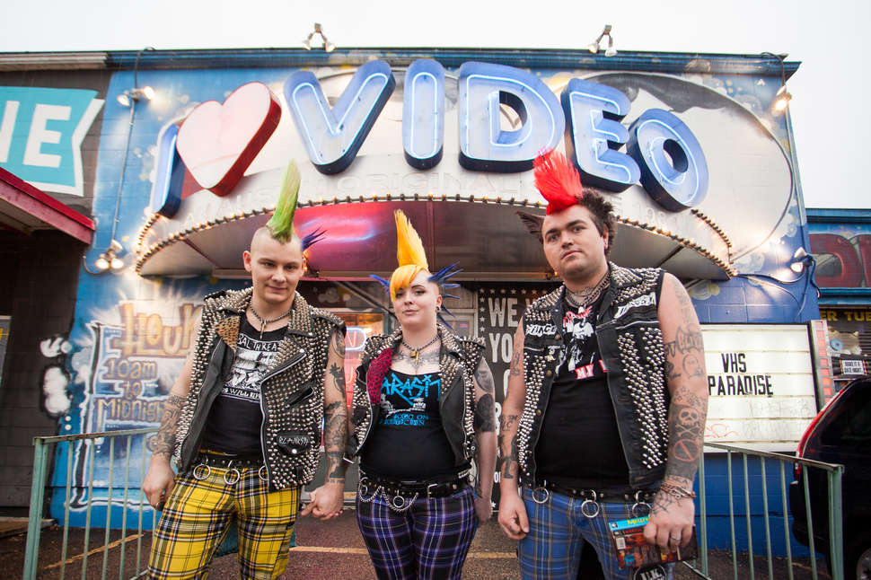

Slide 28
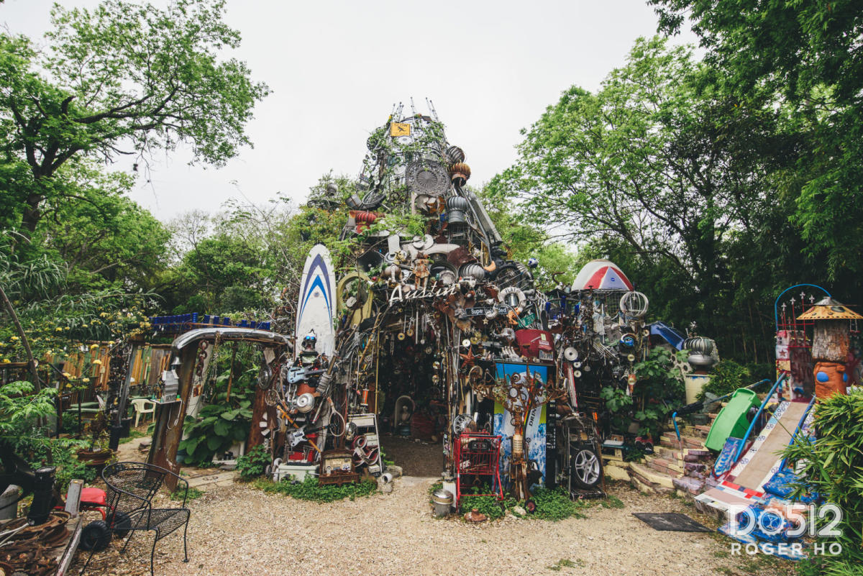

Slide 30
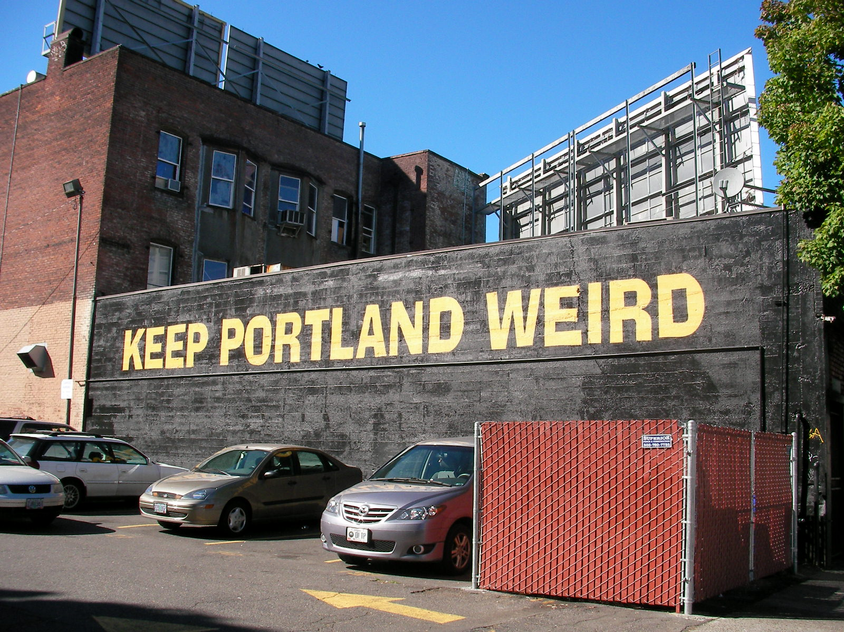

Slide 31
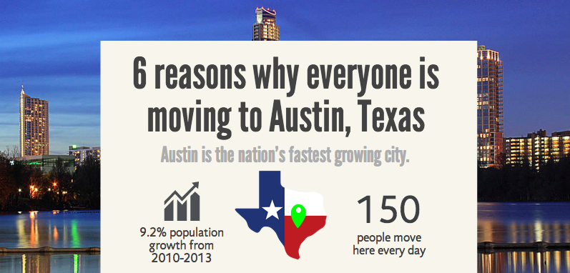
Discipline, Focus, Consistency

Slide 32
Seven plots
overcoming the monster
rags to riches
the quest / voyage & return
hero in a hole
comedy
tragedy
rebirth
Notes:
There are only seven plots in human history. Maybe eight. Or six. Theorists fight over this. Christopher Booker.

Slide 33
Seven plots
overcoming the monster
Notes:
There are only seven plots in human history. Maybe eight. Or six. Theorists fight over this. Christopher Booker.

Slide 34
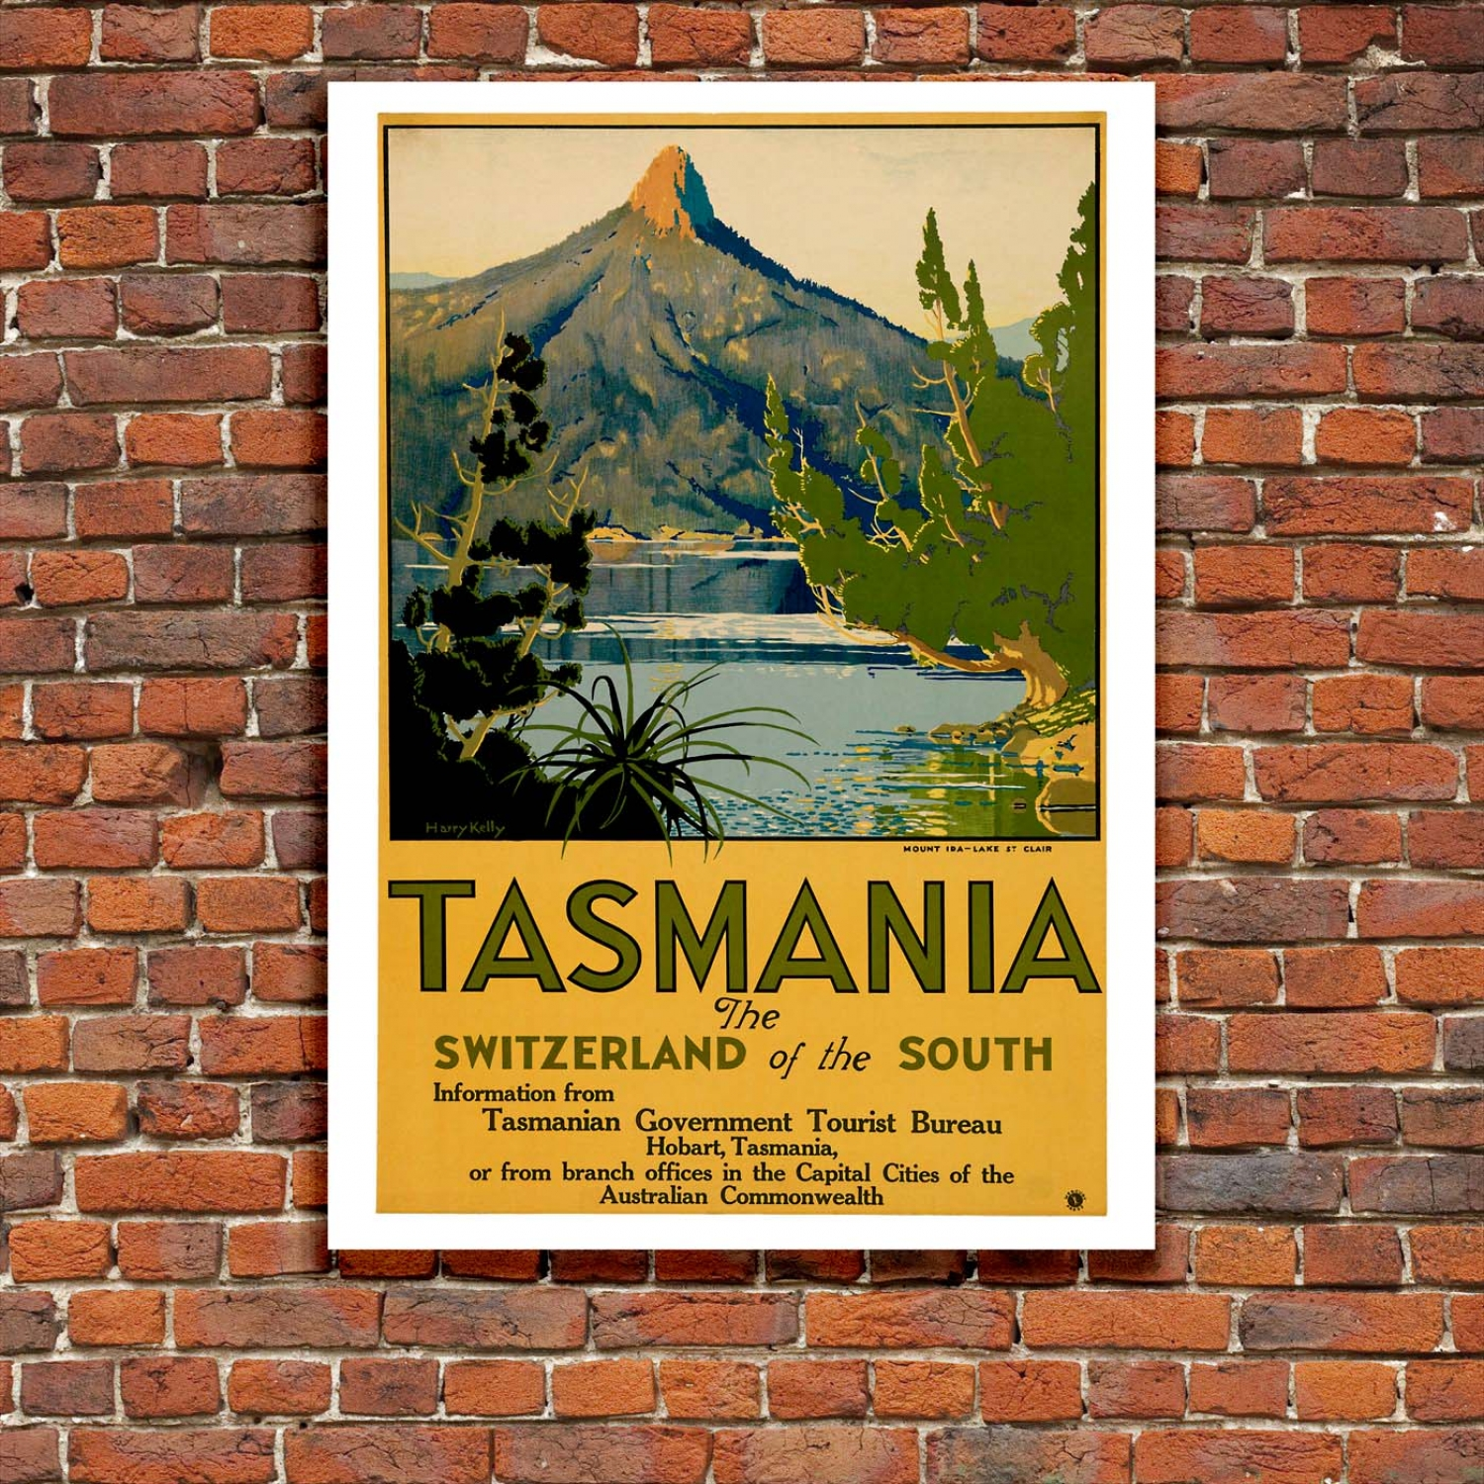

Slide 35
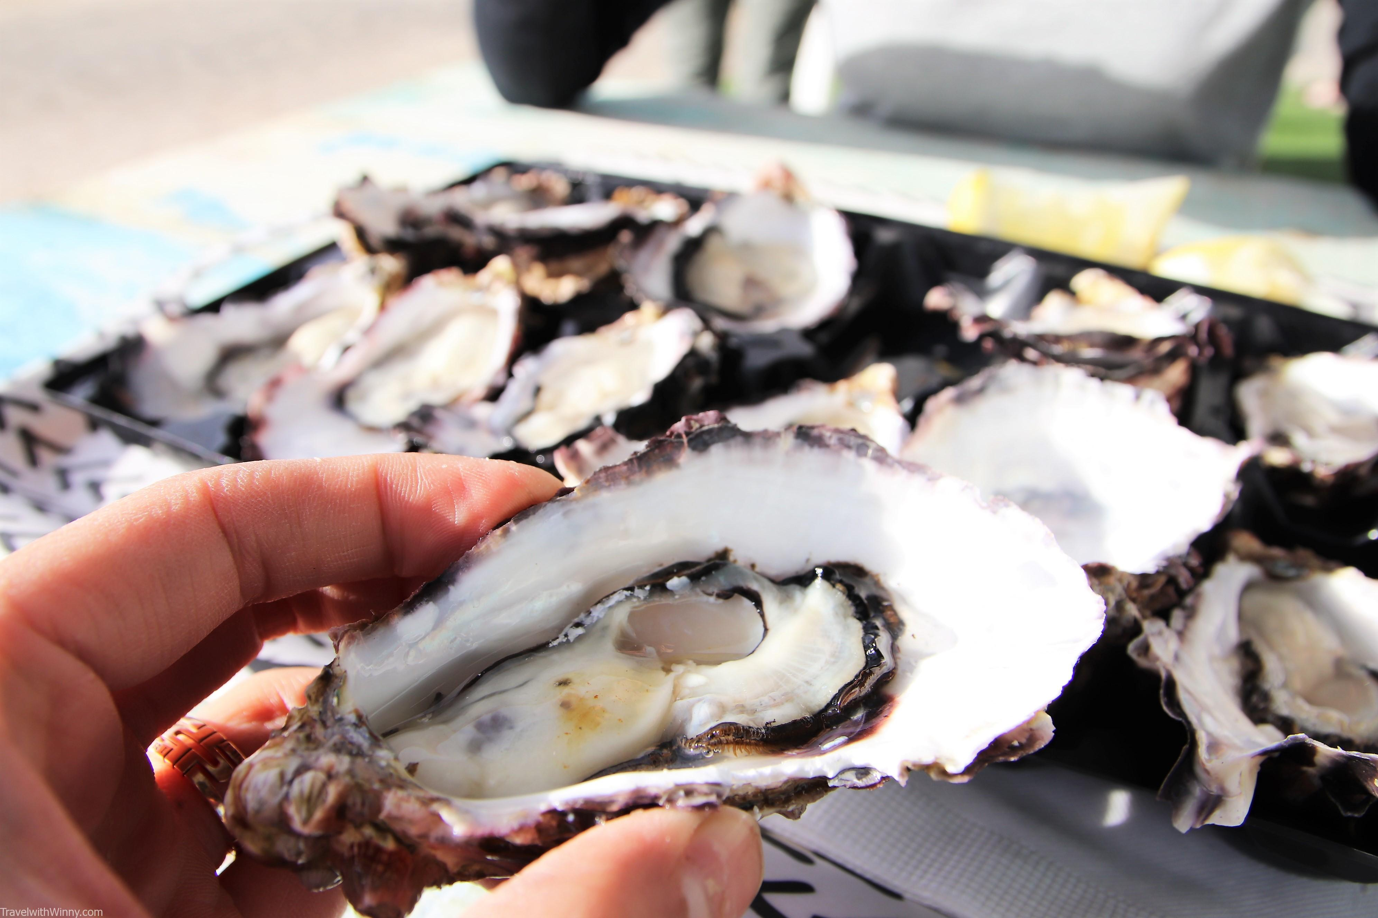

Slide 36
Tasmanian story work
200 interviews
335 pages of notes
147, 959 words
The interviewees were chosen by a random sample with representative socio-economic, geographic, age, and gender diversity representing the Tasmanian population

Slide 37
A Place brand
Express where we live
Express who we are
Express what we do and why we do it
Help everyone use it

Slide 38
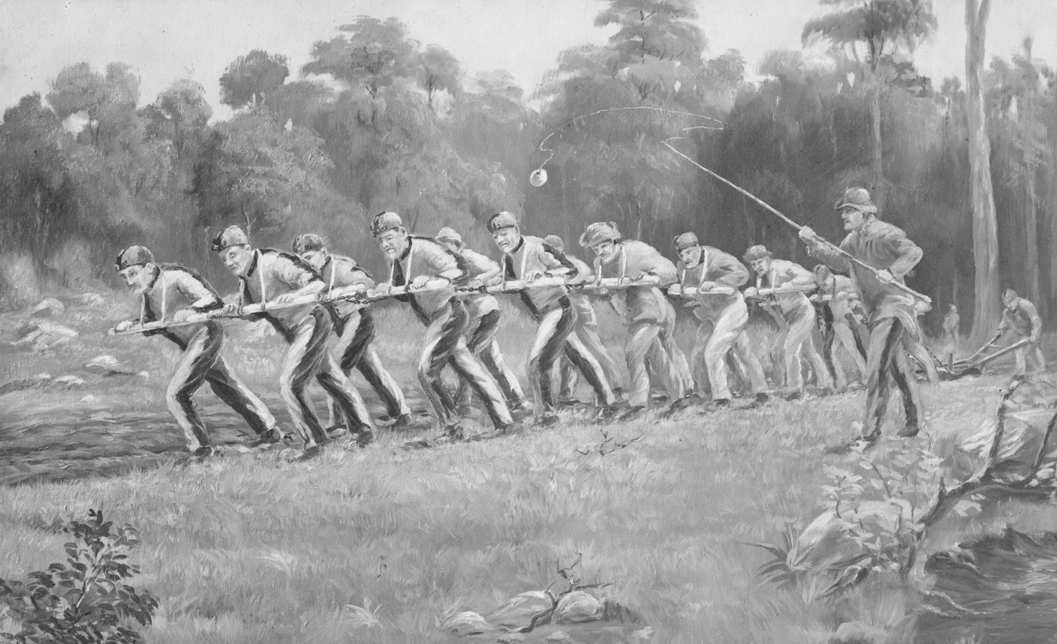

Slide 39
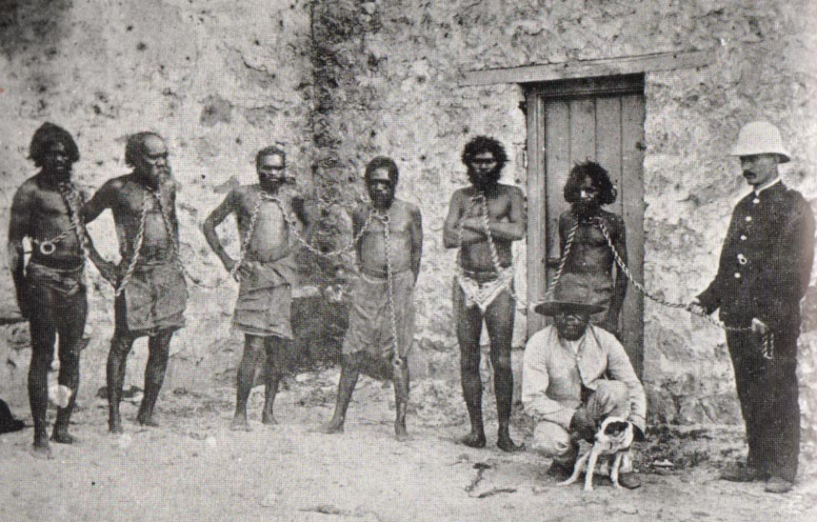

Slide 40
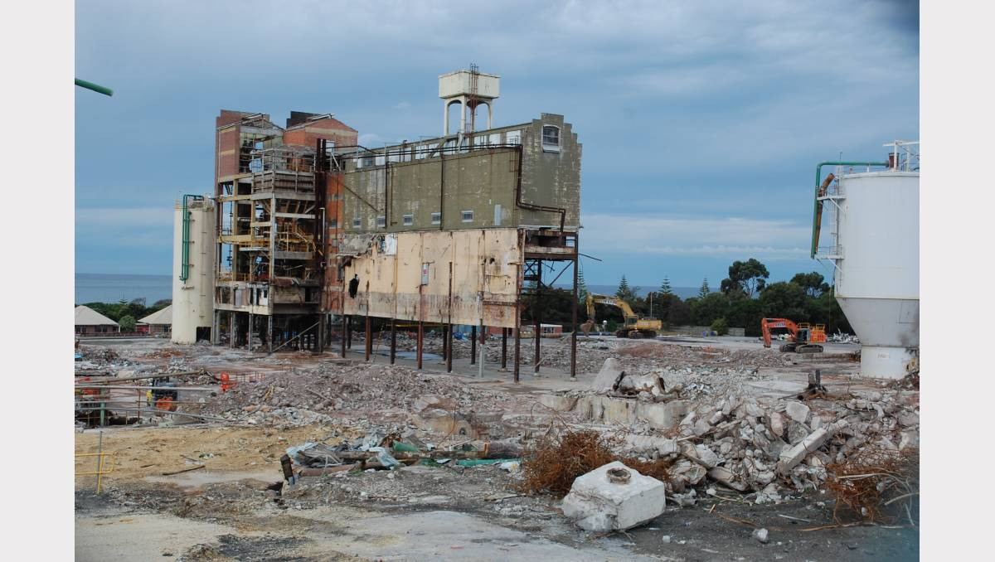

Slide 41
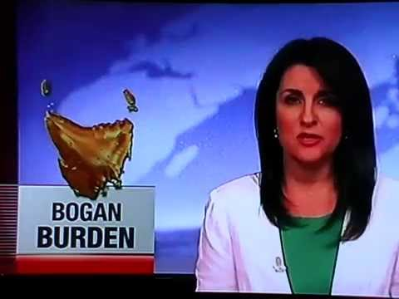

Slide 42
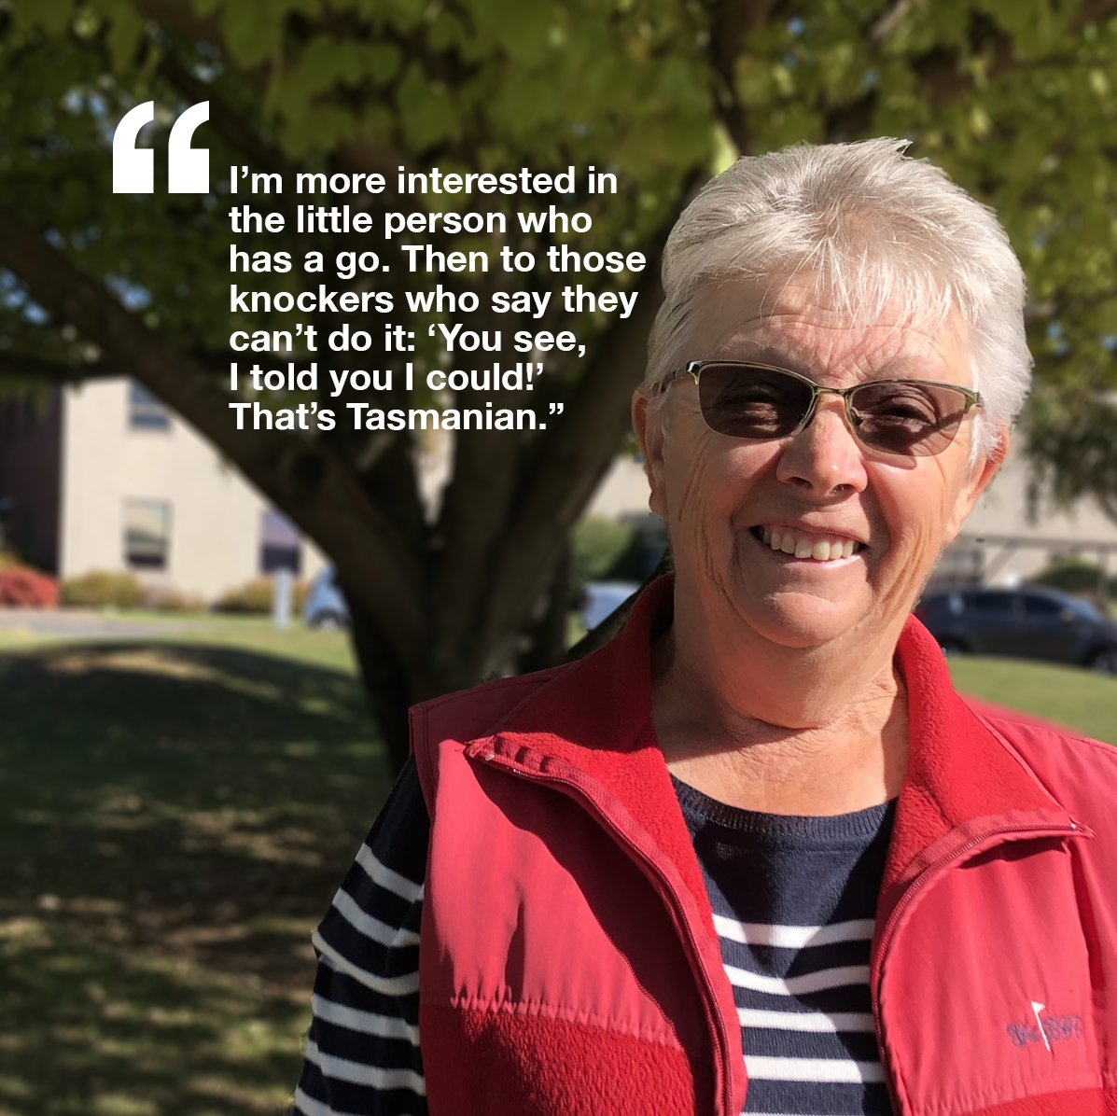

Slide 43
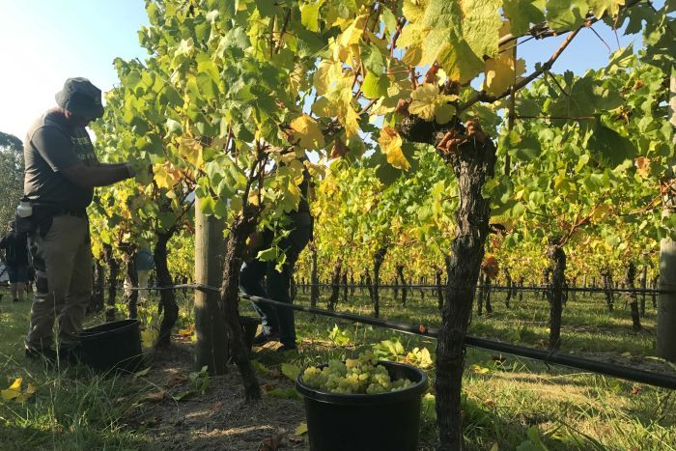

Slide 44
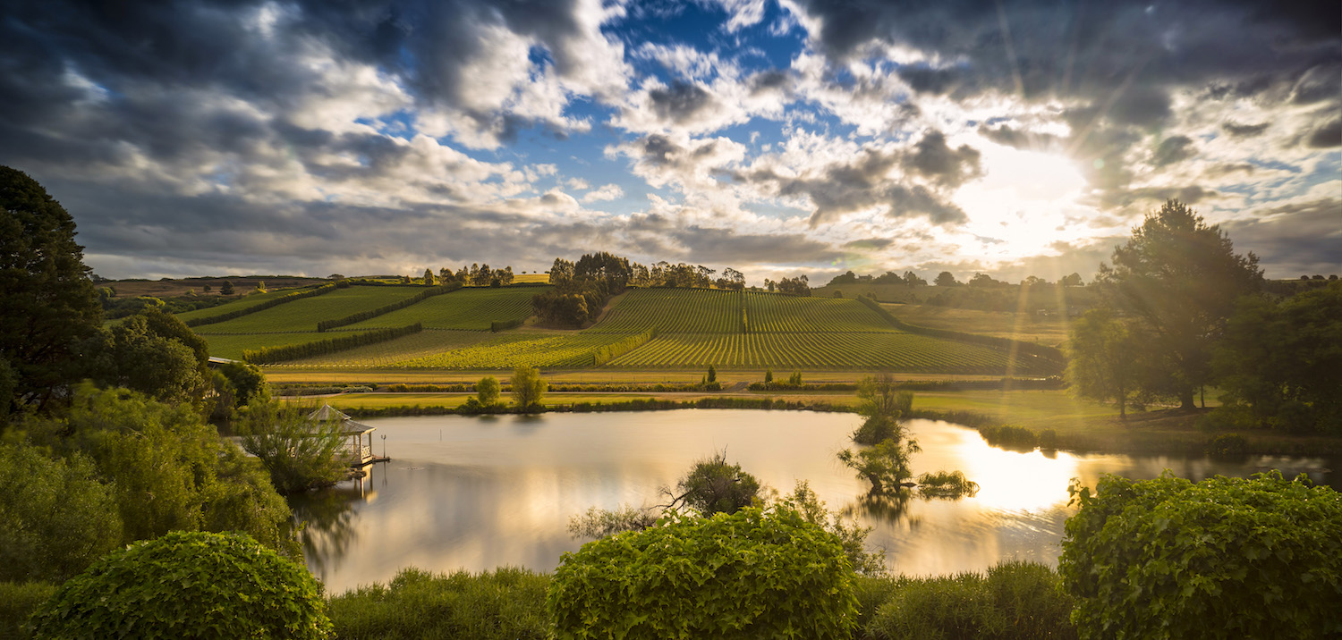

Slide 45
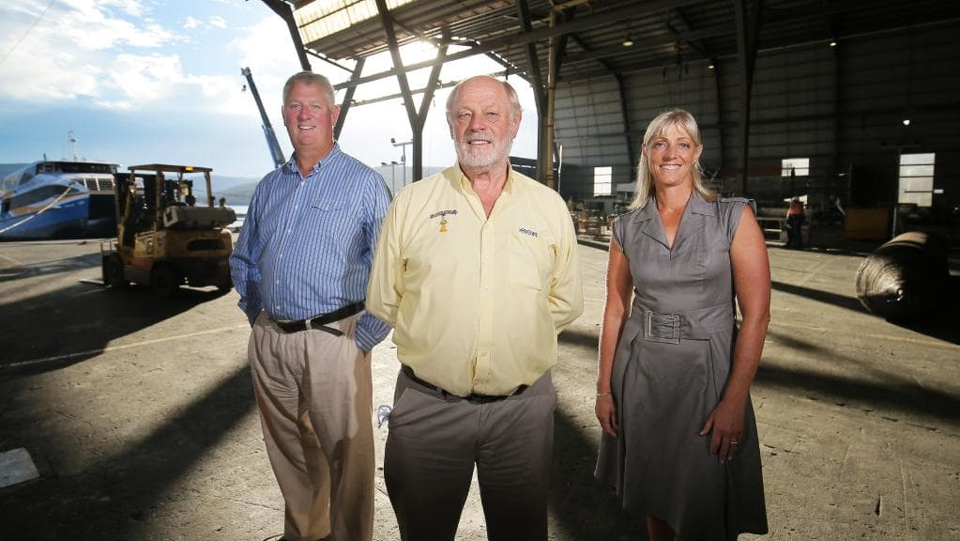

Slide 46
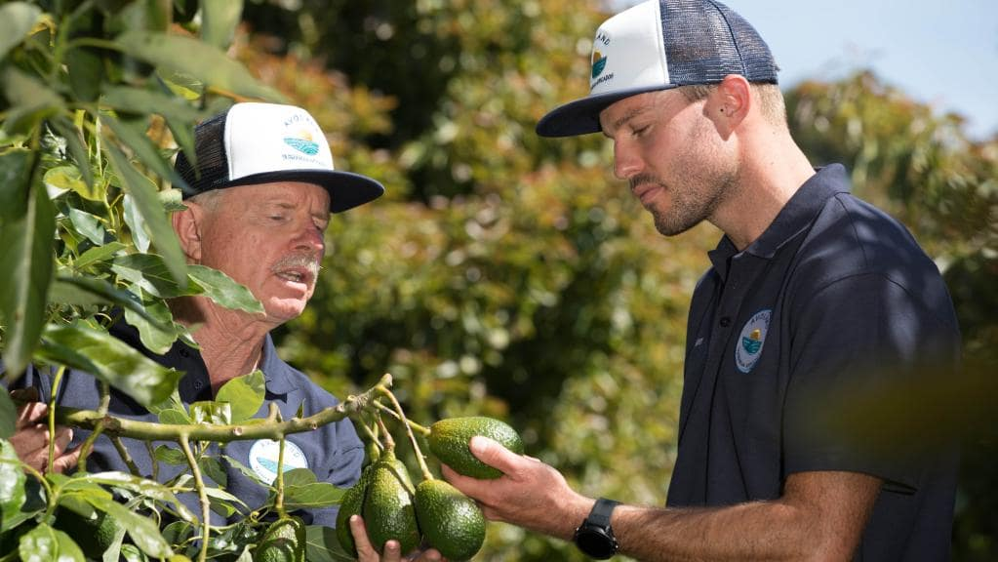

Slide 47
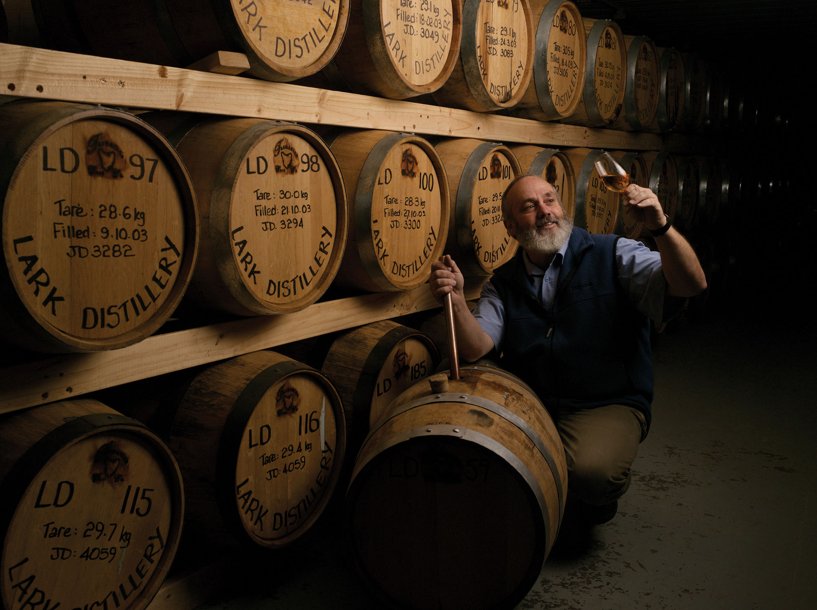

Slide 48
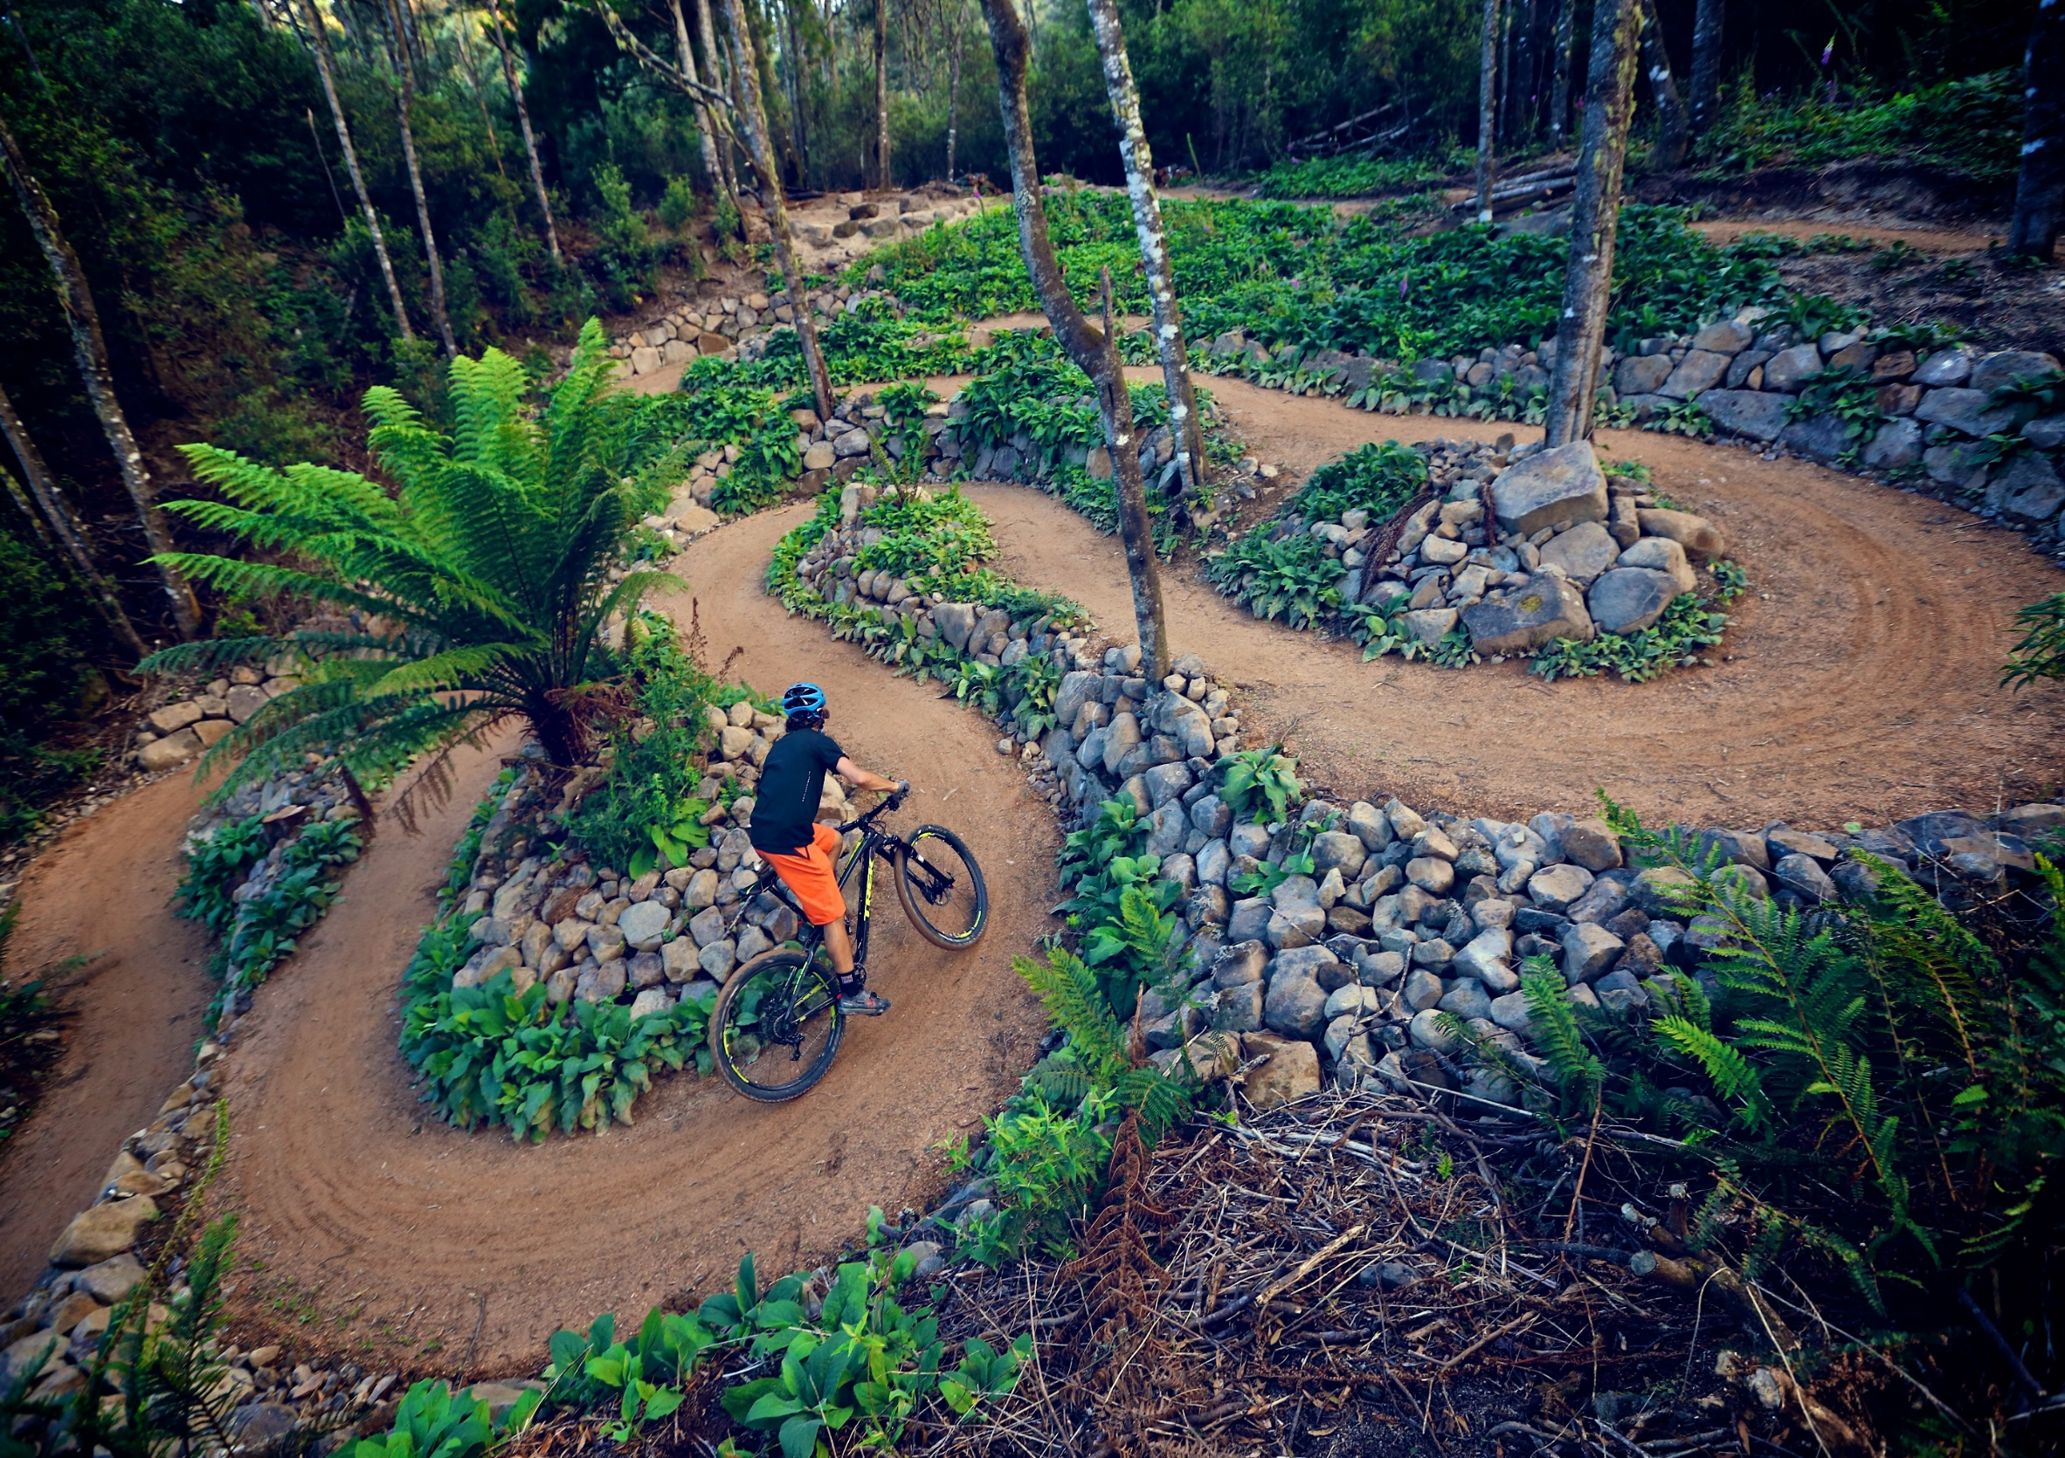

Slide 49
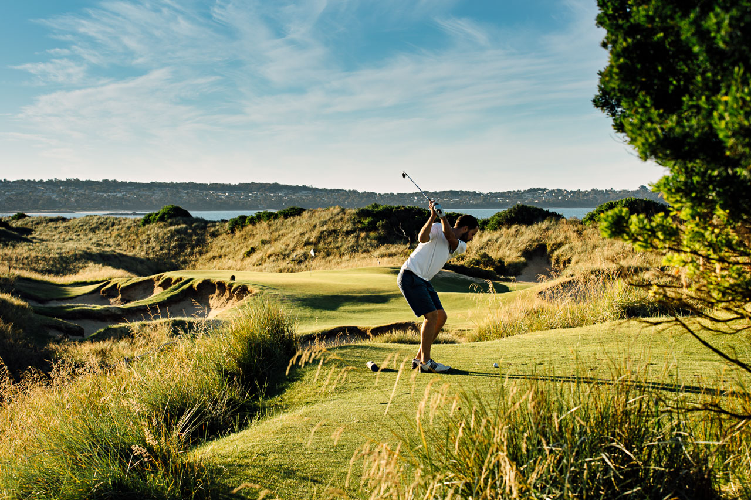

Slide 50
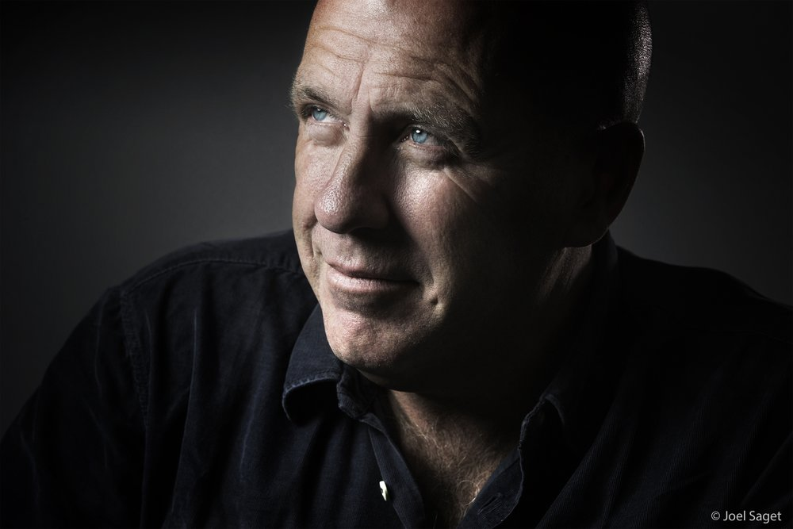

Slide 51
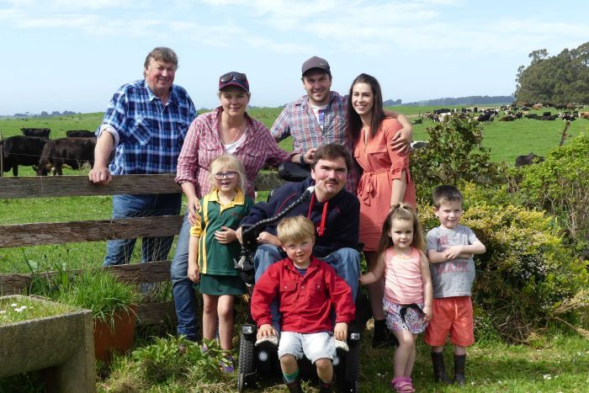

Slide 52
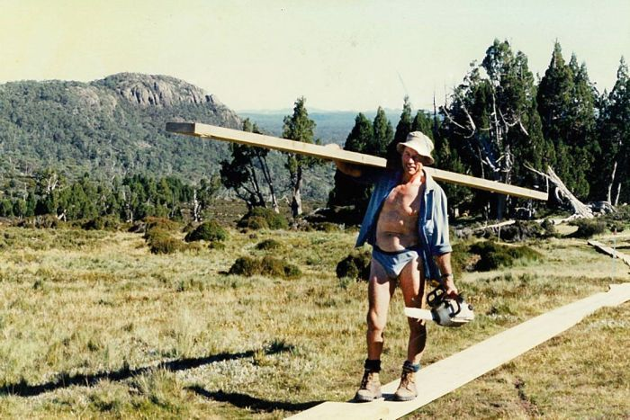

Slide 53
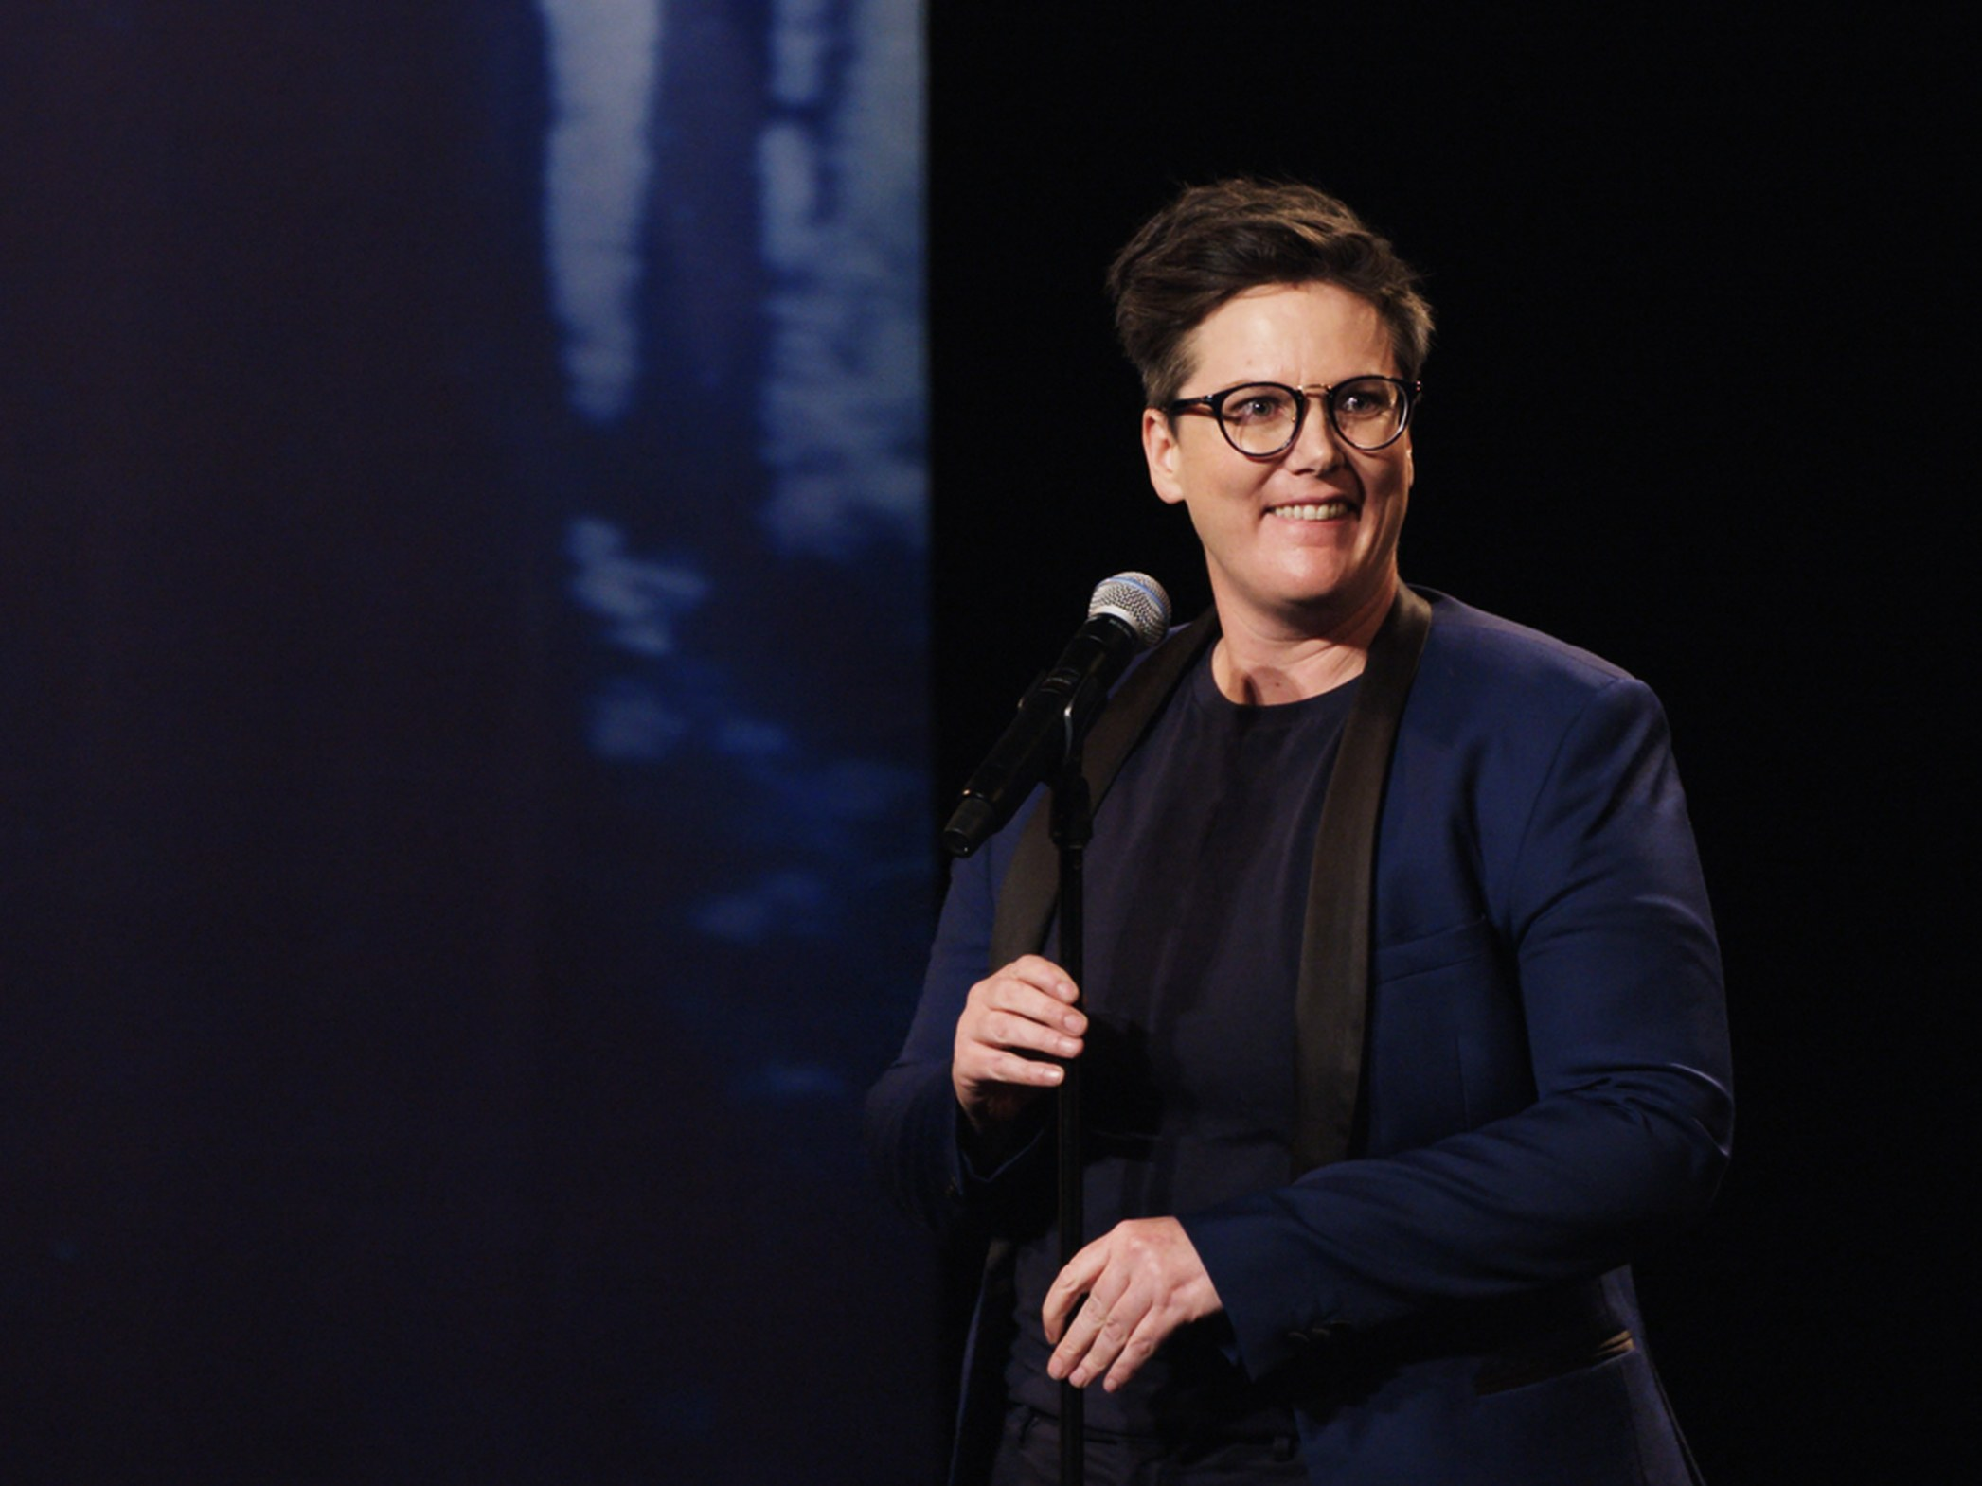

Slide 55
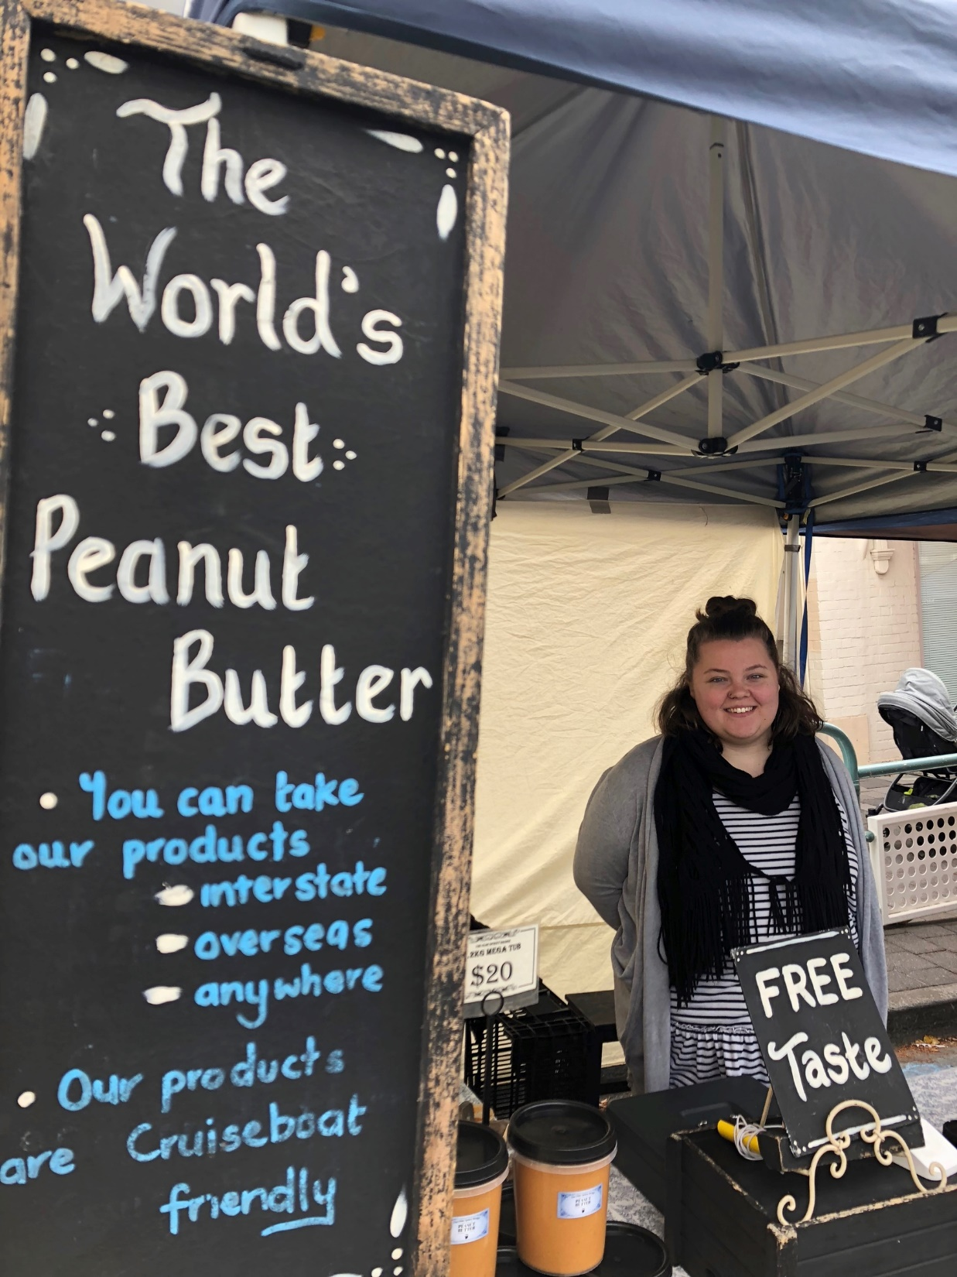

Slide 56
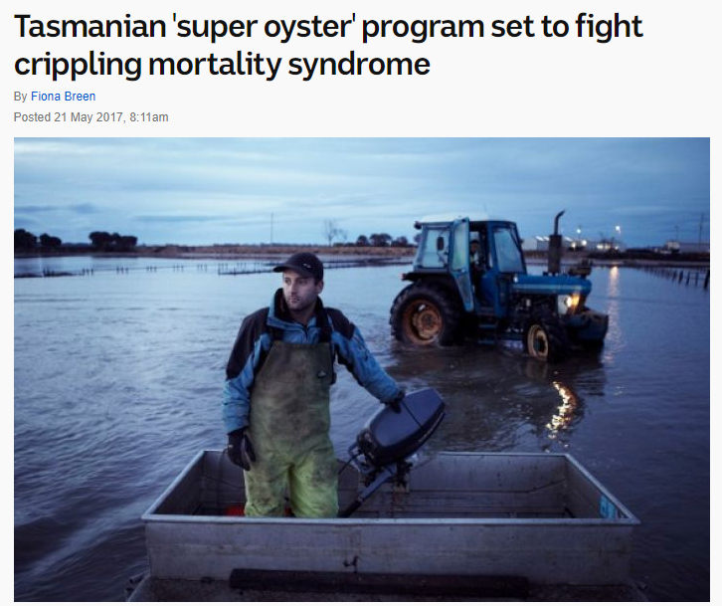

Slide 57
The plot
A narrative always turns, always promises the hope for transformation.
Adversity, hardship, underestimation, “impossible-ism"
To persevere because of this, often breaking the rules
The quiet pursuit of the extraordinary

Slide 58
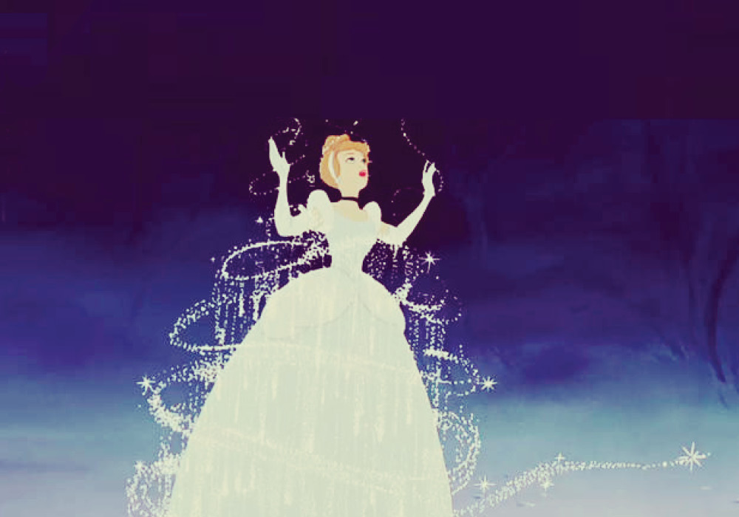

Slide 59
Seven plots
overcoming the monster
rags to riches
the quest / voyage & return
hero in a hole
comedy
tragedy
rebirth

Slide 60
Seven plots
rags to riches

Slide 61
The quiet pursuit of the extraordinary

Slide 62
Tasmanian brand
Tasmania
Tasmanian
Be Tasmanian
Bottom-up rather than top-down: client service

Slide 63
Notes:
The usual way to do this: here is the logo and the rules for using it.

Slide 64
Be tasmanian

Slide 65
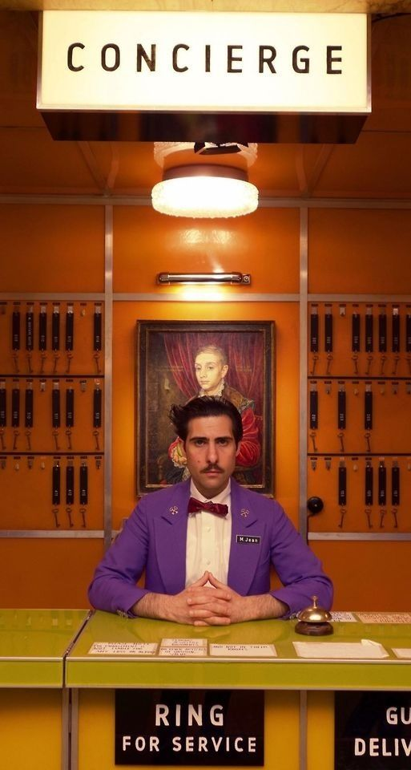

Slide 66
our clients and partners
Tourism
Trade
Work (talent attraction and skills development)
Investment attraction
Live (community, arts and culture, social , educational)
Study (international student attraction)
We approach this work in phases

Slide 67
1. Brand expression and digital strategy

Slide 68
2. Engagement and consultation

Slide 69
3. research, measurement

Slide 70
More than oysters
Oysters
Oysters from Tasmania
Tasmanian Oysters
Your story and the Tasmanian story

Slide 71
“the age of creative entrepreneurship”

