Slide 1
Stay afloat supporting health and wellbeing in the Tasmanian seafood industry
Julian Harrington
Chief Executive - TSIC
Shellfish Futures
August 2019

Slide 2
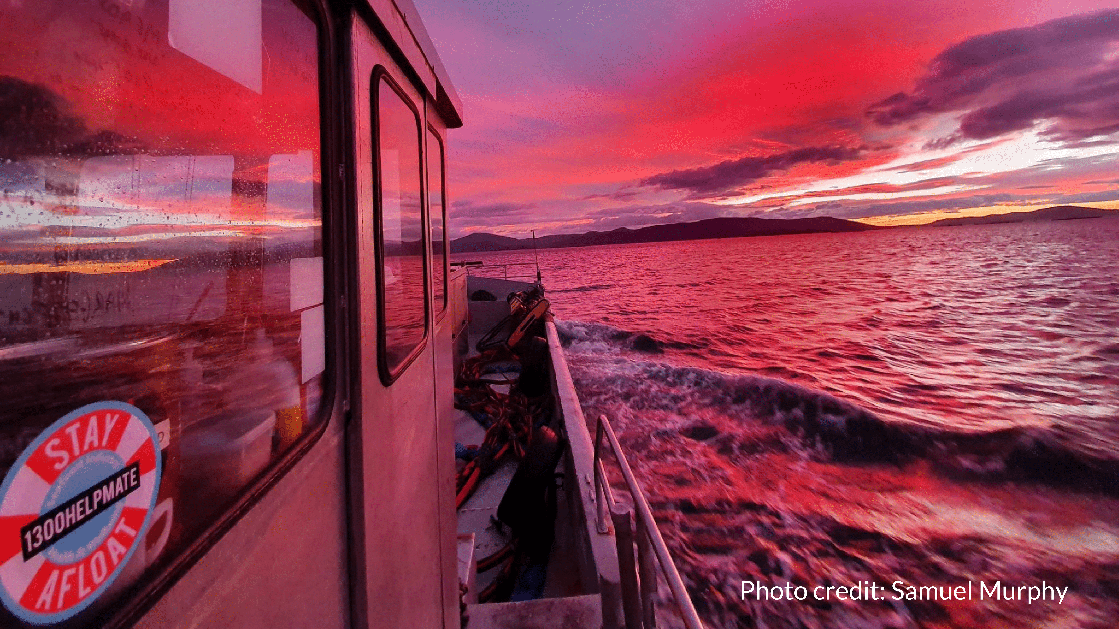

Slide 3
#drownthestigma
#stayafloat

