Slide 1
Marine Resource Economics
Steven Rust
Institute for Marines and Antarctic Studies

Slide 2
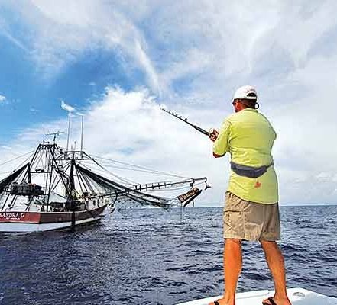
Some of my past projects
Economic valuation of recreational fishing in Tasmania
Capacity and efficiency analysis of the Tasmanian rock lobster fishing fleet
Cost-effectiveness of strategies to eliminate the Spiny Sea Urchin on Tasmania’s east coast
Viability of precision agriculture in nutrient application on sugarcane farms in Mackay
Cost-effectiveness of remediation projects for gully erosion in central Queensland

Slide 3
What is economics?
Economics is more than just finance
Economics is about achieving collective benefits (including to the whole of industry)
It considers trade-offs faced by a decision-maker for alternative practices, policies or investments
It is about making (informed) decisions

Slide 4
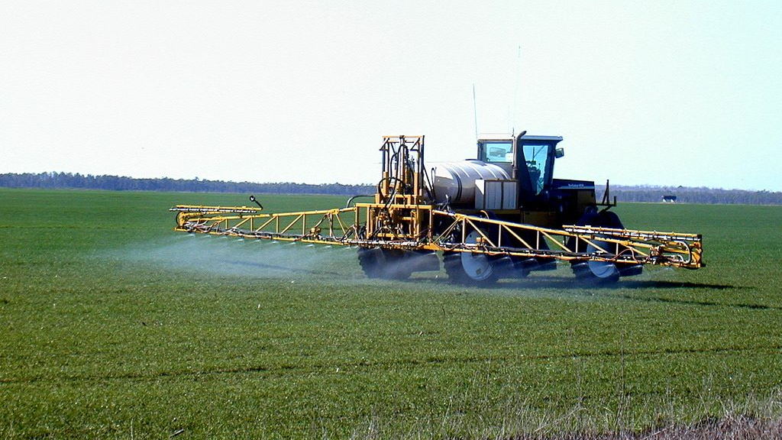
How has it helped agri-food industries in the past?
Changes in commodity prices (e.g. ABARES Agricultural Commodities Report, World Bank Commodity Markets Outlook)
Modelling farm production systems (e.g. Farm Economic Analysis Tool, BreedCow & Dynama)
Assessing the impact of shocks (e.g. bio-security outbreaks, commodity price changes) on the industry and the regional economy
Government policies (e.g. targeting landcare & extension programmes)

Slide 5
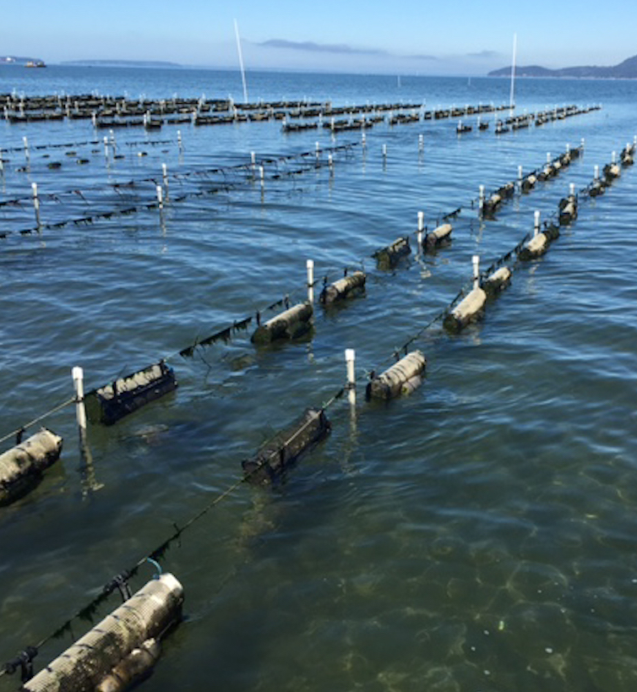
Thinking economically about shellfish…
How economics might relate to the shellfish industry:
Understanding oyster price (i.e. when does it go up/down, and what affects consumers’ willingness to pay?)
Social-economic characteristics of the industry and operators
Ecosystem services – the cost of reduced water quality on production, and the value of bio filtering and carbon sequestration provided by oysters

Slide 6
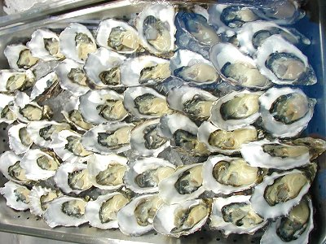
How does the oyster price change?
What is the price of oysters, and how does this vary along the supply chain?
How sensitive is this price to the quantity & type of oysters produced?
If the retail price/s change, what parts of the industry will be affected most, and what impact will this have on the supply chain?

Slide 7
Socio-economic characteristics of oyster growers?
Production | Total commercial production (kgs) combined Total production (kgs) per product
Producers | Number of firms % of firms by share of total production Regional distribution of producers Types of producers
Costs | Costs of production per kg produced Proxy indicators for costs of production per kg produced (e.g. abalone dive rate)
Price | Farm gate price (annual weighted average Farm gate price (variability range) Farm gate price (standard deviation)
Markets | % sales to various markets (local, interstate, o/s) List main markets
Business sustainability | Risk premium (major industrial sub-sectors ONLY) Firm/operator longevity / variability Report major re-structures and changes in number of firms
Domestic outlook | Price indices for major domestically-sold spp. Level of imports of substitutable seafood product to Tasmania and Australia List imported spp. of substitutable seafood product to Tasmania and Australia
International outlook | Price indices for exported spp Terms of trade Global seafood demand trend (‘000 tonnes)
Recreational & Charter tourism fishing | Trend in level of access/allocation for Recreational and charter tourism at fishery level (scoring of relative level of accessibility/ allocation across time)

Slide 8
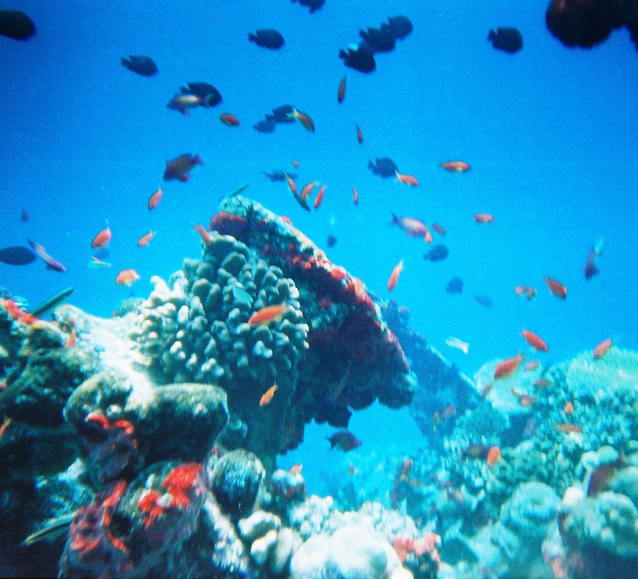
Valuing ecosystem services related to Oysters
Oysters highly connected to their environment
Susceptible to impacts of upstream activities
Also provide services incl. carbon sequestration
What are these worth from a whole-of-society perspective?

Slide 9
Contact details
Dr. Steven Rust, PhD, B.Ec (Hons)
Marine Resource Economist
Institute for Marine and Antarctic Studies
15-21 Nubeena Crescent, Taroona, 7053
Phone: 03 6226 8254
Email: steven.rust@utas.edu.au

Slide 10
Discussion and questions

