Slide 1
Commercial depuration of Pacific oysters
Alison Turnbull & Navreet Malhi
Shellfish Futures, 16th August 2019

Slide 2
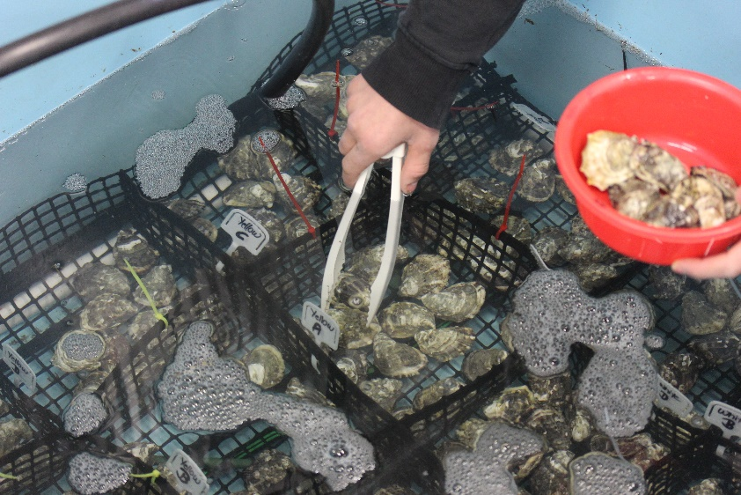
Pilot depuration trial
Diploid pacific oysters
Very low mortality of around 1 %
High variability in PST results
PST level start = 2.8 mg STX eq. kg⁻¹
Around 3.5 days to depurate below regulatory level

Slide 3
Commercial depuration proposal
Reduce the impact of PST blooms
commercially feasible option to ensure continuous market supply during bloom season
reduce the shell stock left in the growing area due to blooms that could potentially be impacted by POMS
Provide scientific evidence to ShellMap
2 facilities, starting with variability trial in each
10 trials in each facility
Stop/no go points
Boundy method of analysis - AST
Model depuration for each plant, combined model for all data collected
Viability assessed
Estimated cost $370-400 k over three years
plus $25k in-kind from industry, $95.5k in-kind from SARDI

